Slide 2
MK1.4 +AC Generator
November 21st, 2021

Slide 3
Outline
Problem Statement
Mitigation Plans
1.4+AC Generator next steps

Slide 4
Problem
Chip shortages constrain the supply of Bel inverters. The 1.4 requires (2) Bel Inverters (Arena P/N 10000663, Mfg P/N BCV200-350-8S577).
Delivery of production quantities of inverters were pushed back from Jan 2022 to June 2022
There is line of sight on (70) MK’s worth of inverters, allowing for a total of ~110 MK’s to be built by EOY
It is necessary to target a solution first for the Sprinter platform as we must build on Sprinters until receiving Transits in ~March 2022

Slide 5
Mitigation Plan
Find replacement for Bel inverter
Requirement's sheet created
List of inverters researched in the past has been shared (linked here)
Replacements are scarce, and will also require SW work to integrate into our control
Utilize an AC generator (like the 1.3), bypassing the need for inverters
Can prototype with available PowerTech PTI-30 30kW diesel generator in stock in Lawton (8 in stock)
Powertech getting back to us with availability of 25kW and 30kW diesel generators
Mount in rear battery compartment

Slide 6
1.4+AC Generator next steps
Identify generator options
First choice would be the PowerTech PTI-30 (linked here) as we have inventory for prototyping in house, and we are familiar with this unit from the 1.3
(8) in stock in Lawton
Additional quantities available in February (Patrick to confirm numbers)
Preferable to find a gas replacement for use on Transit
Complete survey for additional generators
Requirements
25kW+ output range with 120VAC/240VAC output
Weight <1,250 lbs
Prefer Diesel for Sprinter, gas for Transit
Gas may be a challenge due to a DOT regulation on gas fuel flow

Slide 7
1.4+AC Generator next steps
Solidify requirements
Do we need shore power transfer switch for refrigeration, heat, and charging aux battery? Yes.
Do we want to build in 1.4 charging capability? We could put (3) 240V, 50A receptacles that would allow (2) MK’s charging at 50A, or up to (4) charging at 30A
Go w/(2) receptacles per MK
If we are charging, it would be beneficial to have a larger fuel supply to avoid need for overnight filling
Not possible for sprinter
Determine if we can go w/AC refrigeration compressors, evaluate 24VDC converter

Slide 8
1.4+AC Generator next steps
Design and Prototype
Design a prototype consisting of
Rear mount PTI-30 Generator
Kick-off 20G assessment w/EASi
Kick-off acoustic enclosure design
Take baseline reading on AMY, estimate where we can net out w/improvements
Run fuel pickup
Prototype harnesses and changes to load center
Locate switch on bulkhead
Evaluate split vs. single load center
Design in 12V power supply (aux batteries) for 12V needs
Specify and source a rectifier or swap to AC compressors for refrigeration
Identify potential locations for garbage

Slide 9
1.4+AC Generator next steps
Balance impact on 2.0
Do we need to shift and incorporate the generator into the launch config of the MK2.0 (Transit)? Yes.
Prototype vehicle
Consider using IVY for prototype #1 (not production)
Use production 1.4 for vehicle #2
Schedule a Design Review for Gen variant (Op’s + Legal)
Noise – Where do we think we will end up
Trash – What will we loose
Include Mike D, Logan, Culinary, Legal

Slide 10
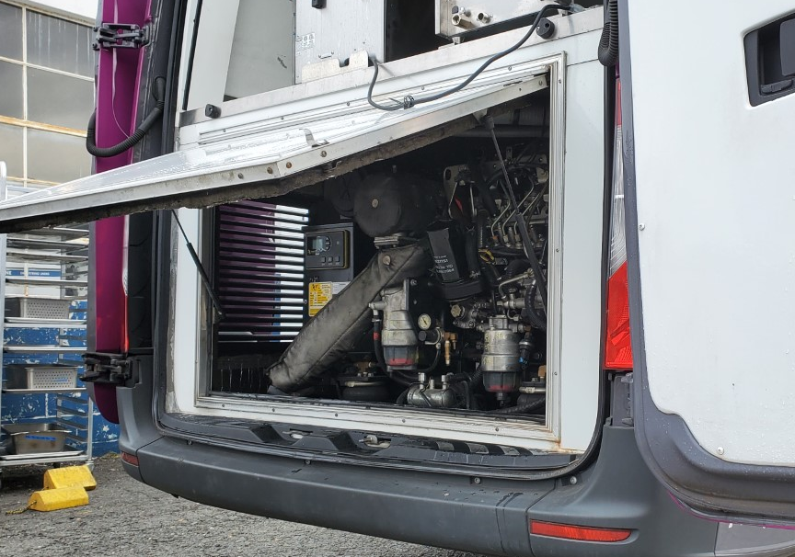
Reference (rear mount gen on 1.3)
Picture on right is of AMY which features the PTI-30 with a rear mount
There is an enclosure to block out sound and fumes to the kitchen
Large vents on curbside and streetside without acoustic treatment

Slide 11
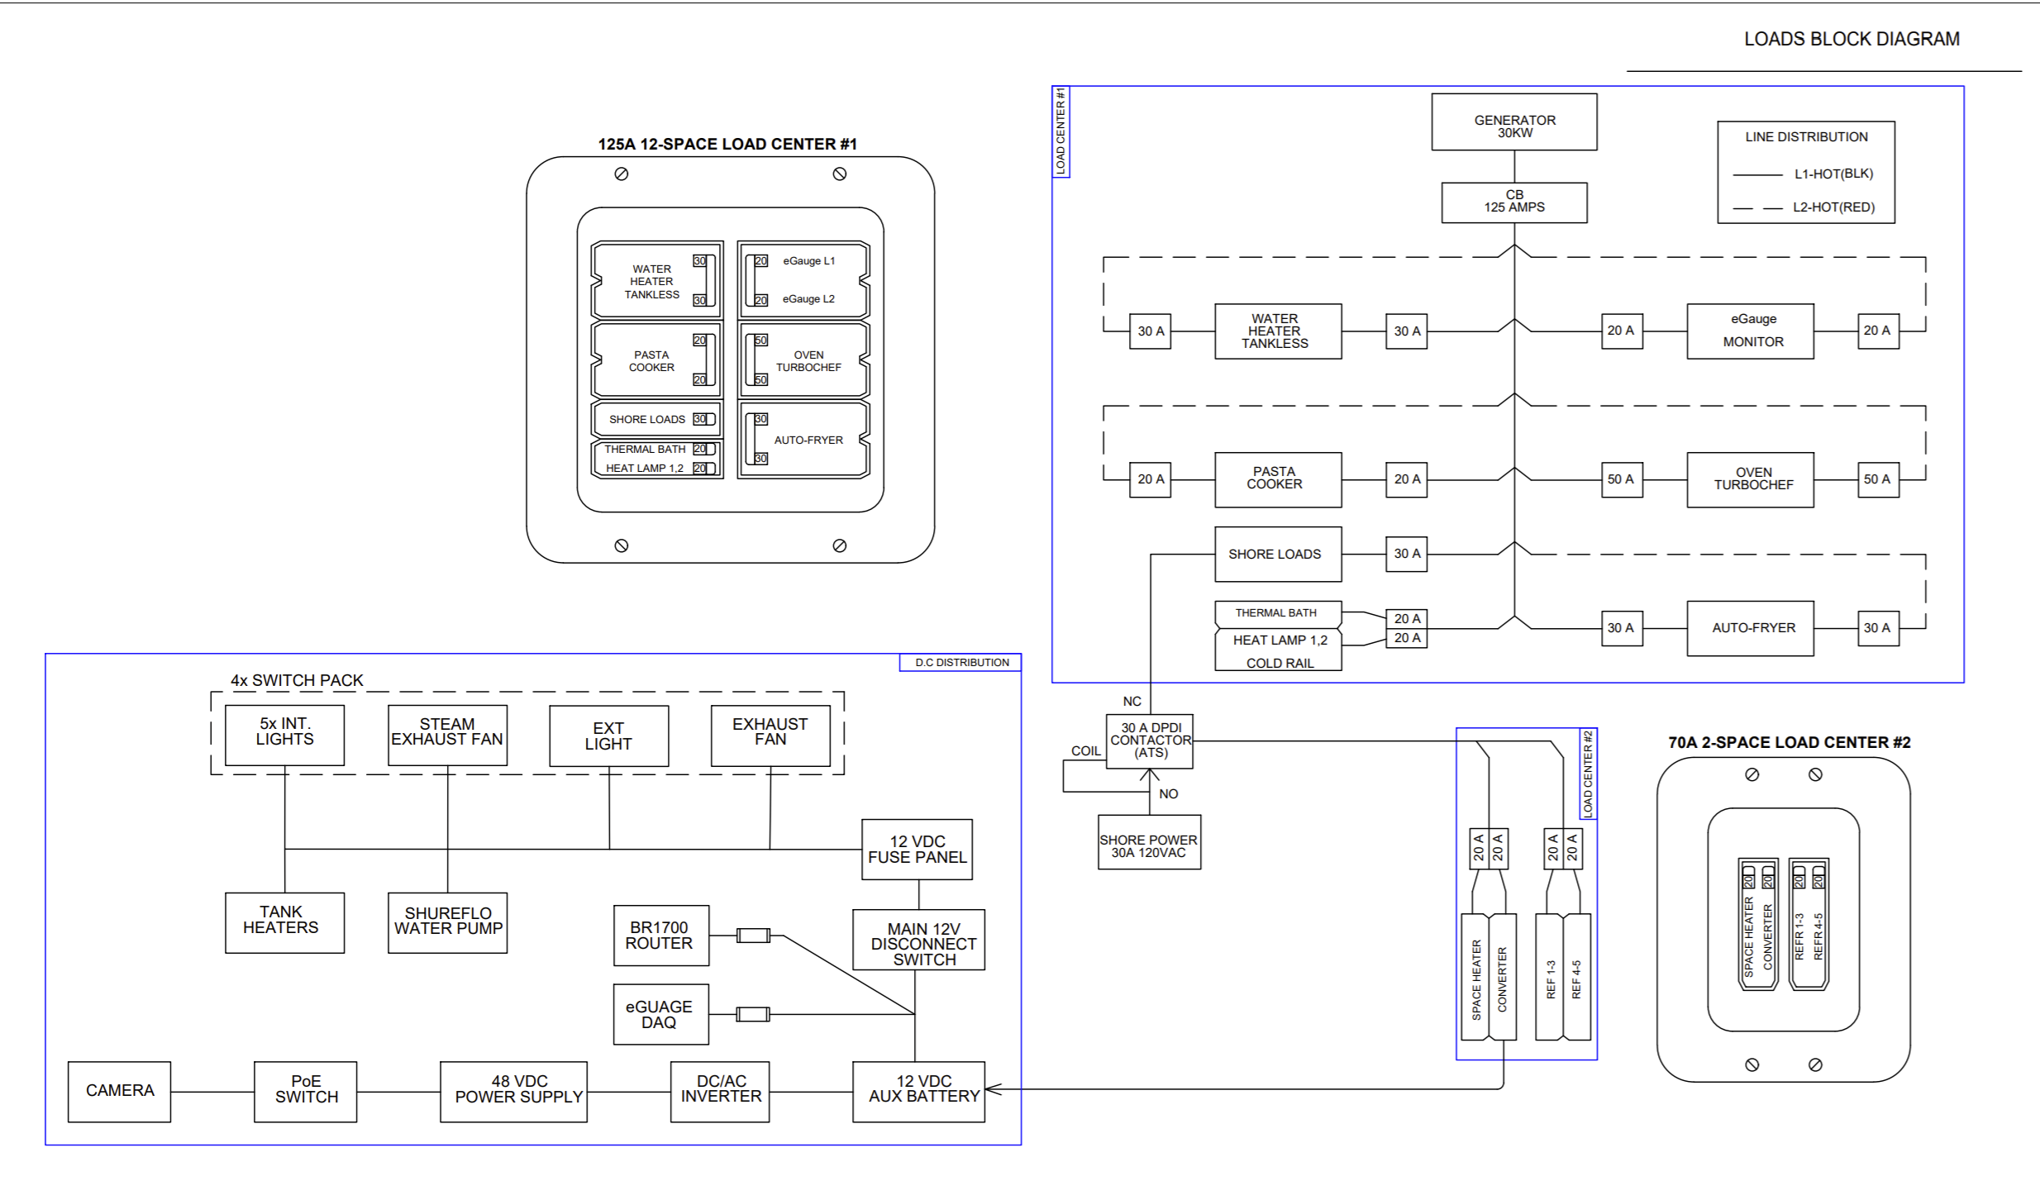
Reference (1.3 Block Diagram)

Slide 12
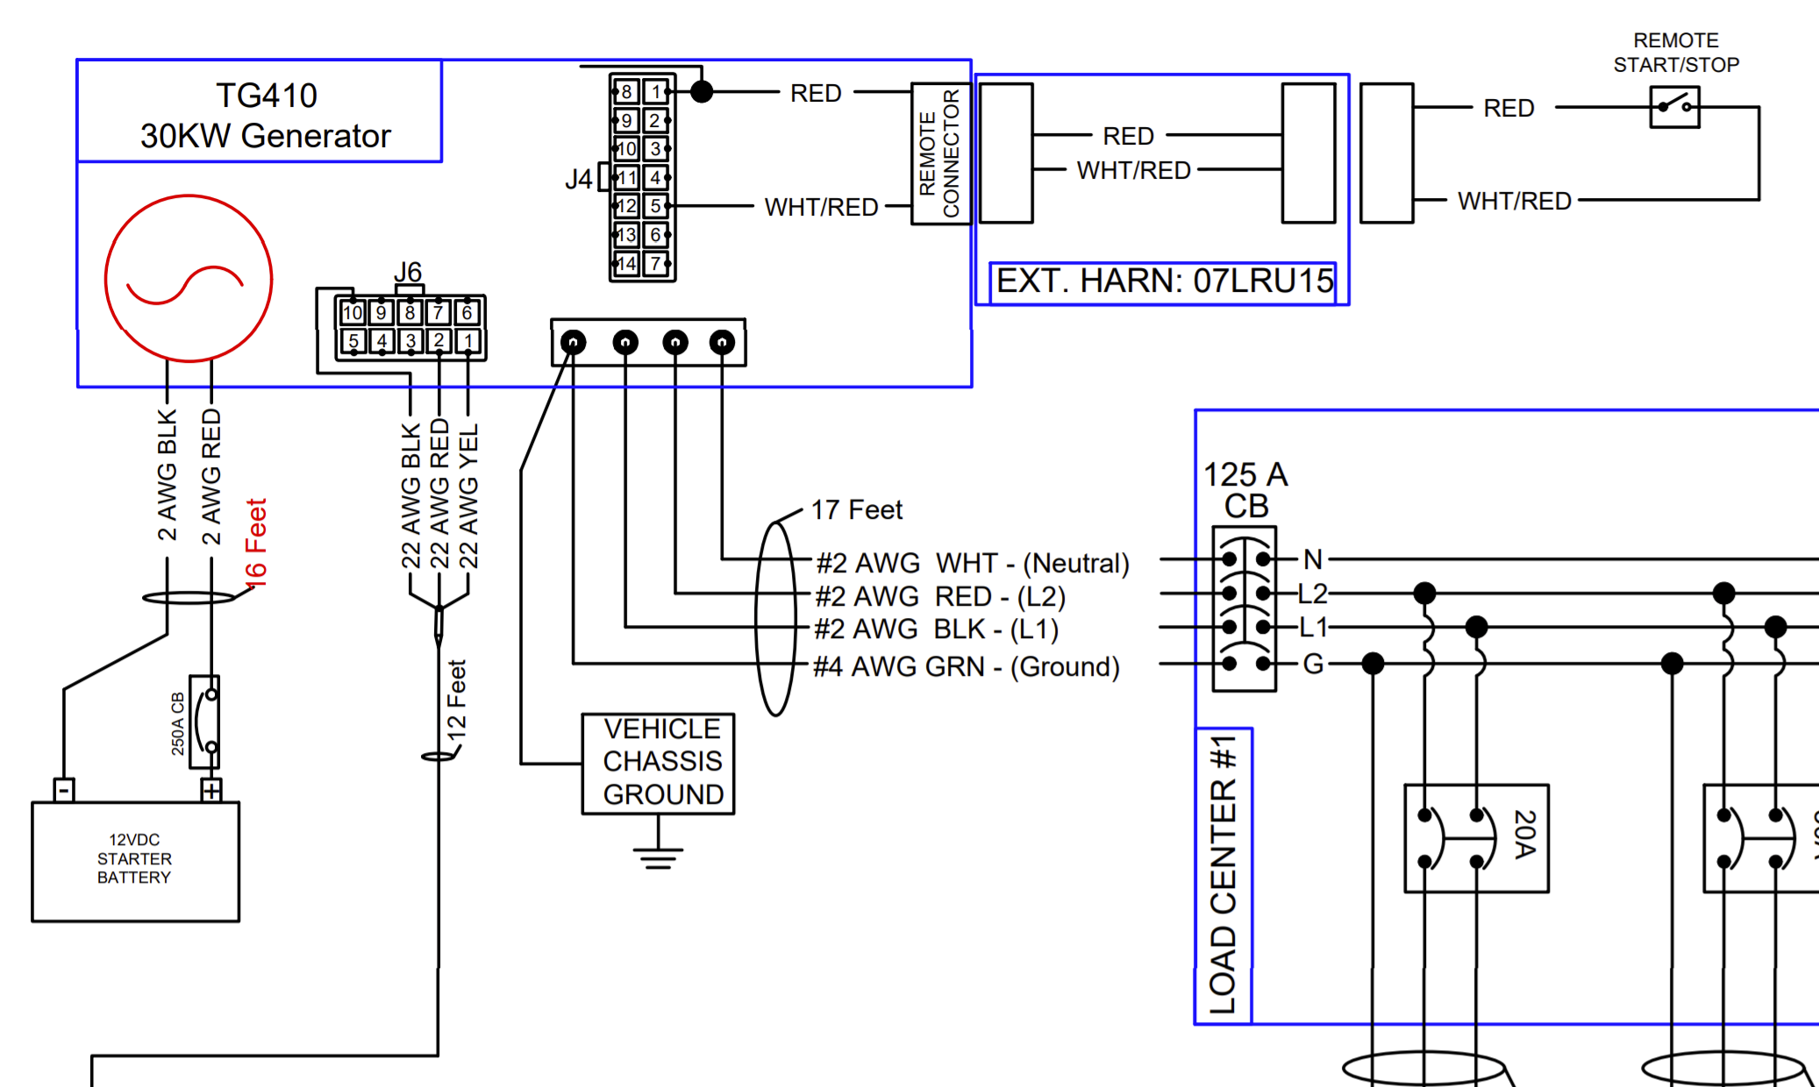
Reference (1.3 Gen to Load Center)

