Slide 1
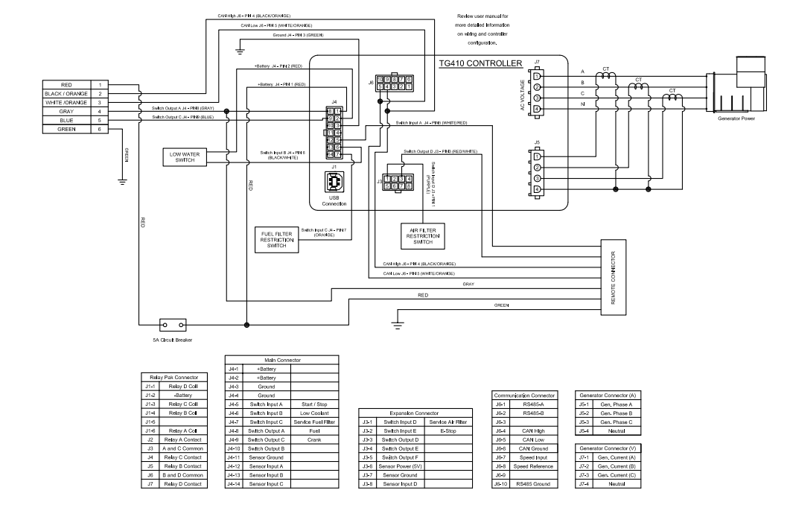
Generator
Connector (A)
Communications
Connector
Display?
Main Connection
Expansion
Connector
Generator
Connector (V)

Slide 2
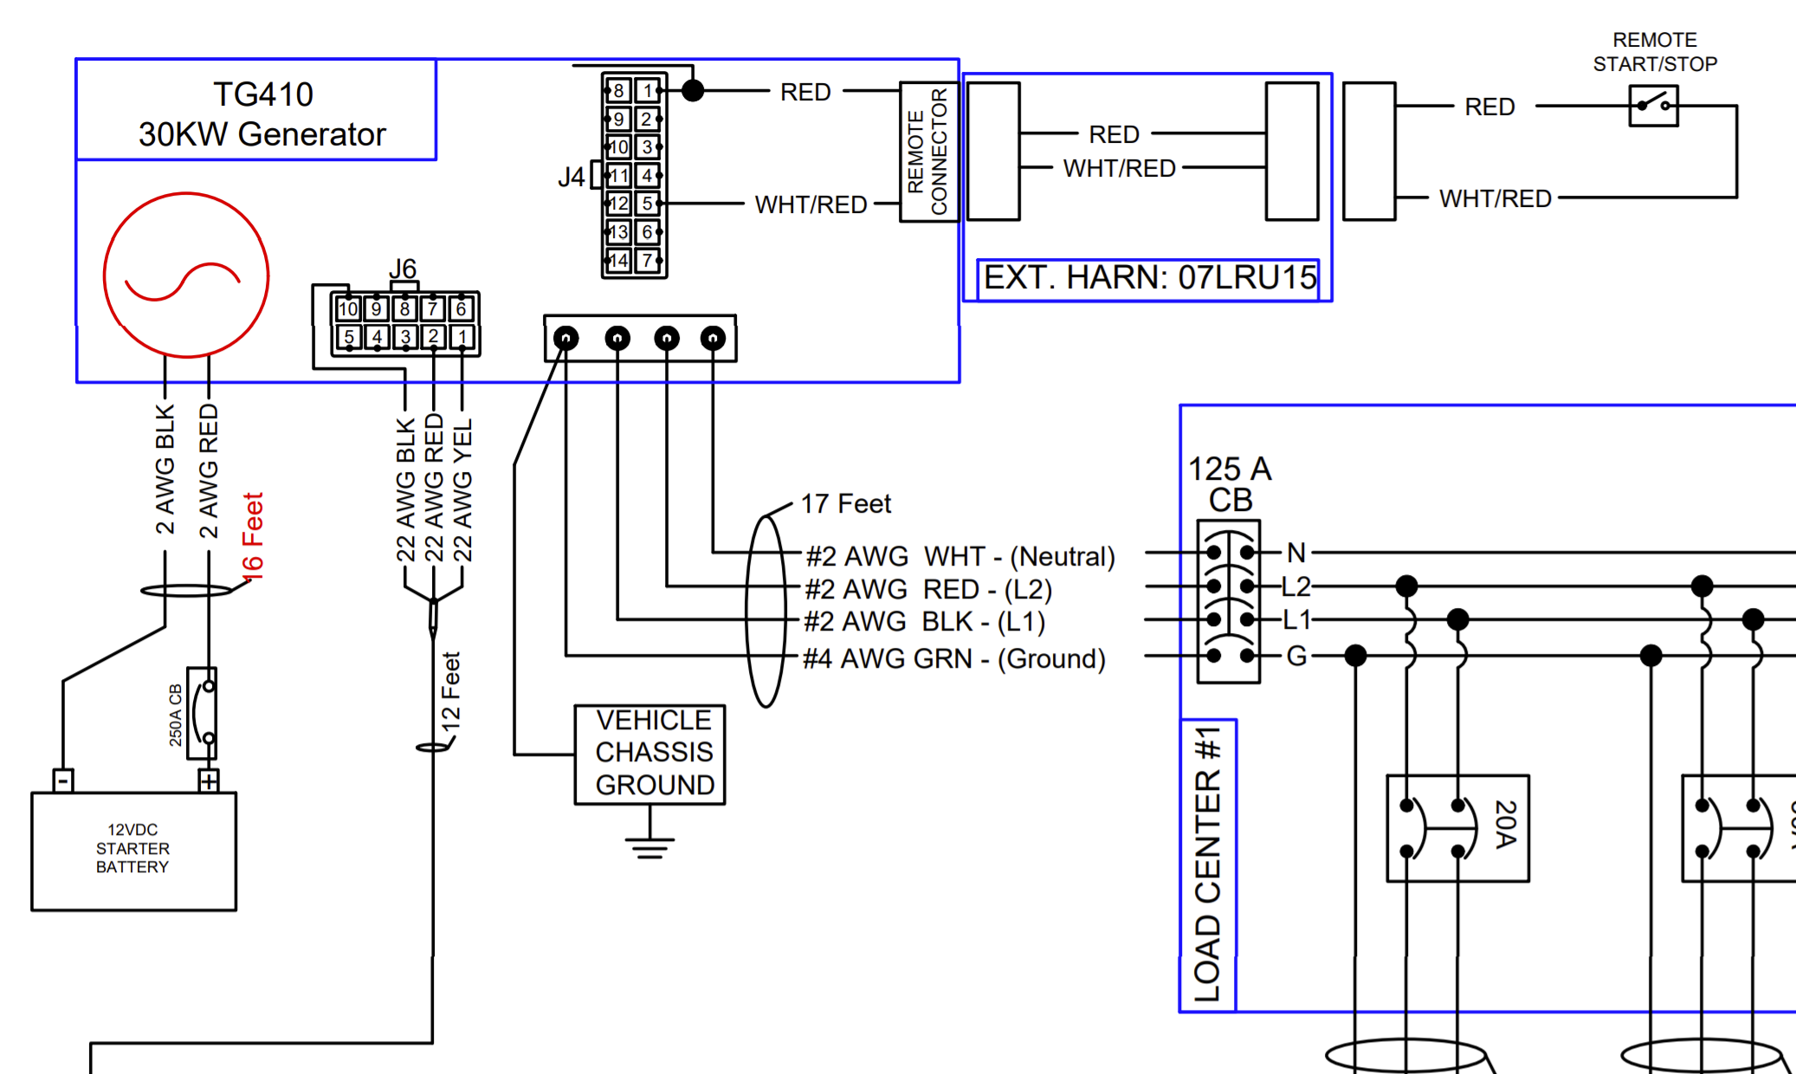
J4-3?
J6-4? CAN High 20AWG
J6-5? CAN Low 20AWG

Slide 3
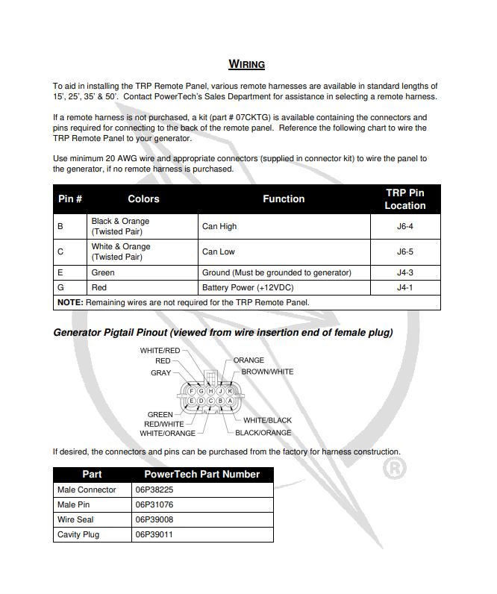

Slide 4
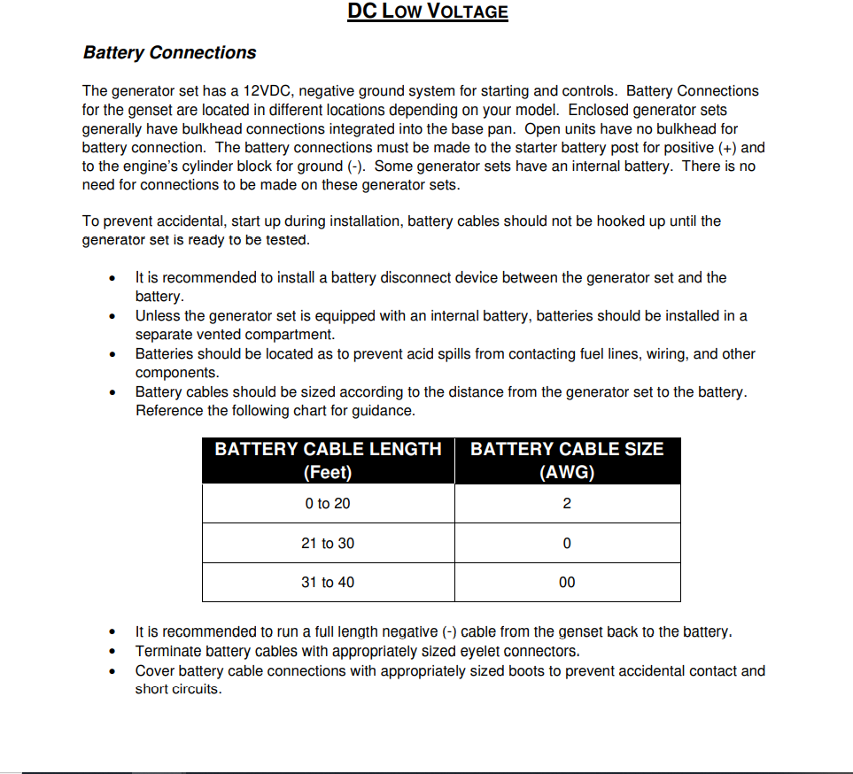

Slide 5
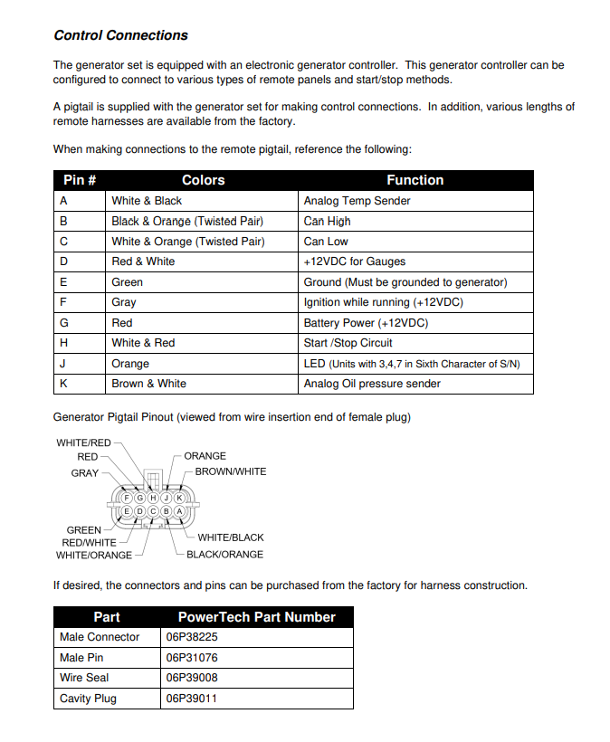

Slide 6
