Slide 1
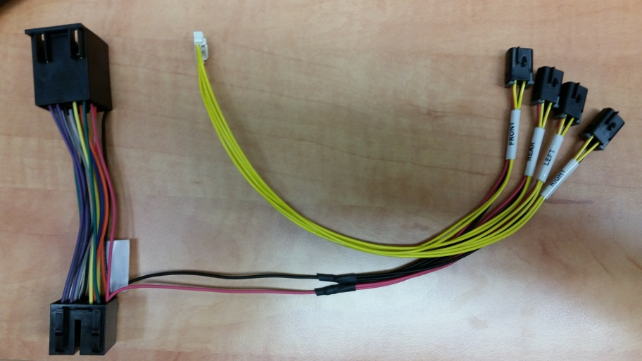
Camera Installation Guide w/ SmartNav 2.0
Parts required to order from PACCAR Parts
1x PP207020 Adaptor Harness. This allows up to 4 cameras to be connected

Slide 2
Adaptor Harness PP207020

Slide 3
Two Camera Vendors via PACCAR Parts
Pana-Pacific
Left, Right, Forward, and Back-up Camera available
Installation Instructions – See following slides
Velvac Camera Kits
Left, Right, Forward, Camera available
Installation Instructions – See following slides

Slide 4
Pana-Pacific Cameras/Jumpers Through PACCAR Parts
Cameras
Available Camera kits. Kits include a camera and extension harness.
PP807032 – Front Camera with 16 ft cable
PP804395 – Rear Camera with 70 ft cable
PP804396 – Right Side Camera with 16 ft cable
PP804397 – Left Side Camera with 16 ft cable
Jumpers
Extension cables are available if a longer length is required:
RRC-10: 10 ft extension
RRC-1: 16 ft extension
RRC-35: 35 ft extension
RRC-70: 70 ft extension

Slide 5
Velvac Cameras/Jumpers Through PACCAR Parts

Slide 6
Velvac Cameras/Jumpers Through PACCAR Parts

Slide 7
Velvac Cameras/Jumpers Through PACCAR Parts

Slide 8
Camera Installation Block Diagram

Slide 9
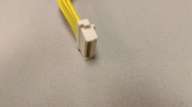
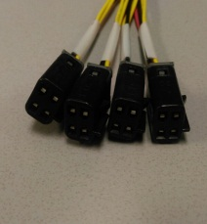
Adaptor Harness
PP207020
PP207020 Adaptor Harness Plugs into Back of the Head Unit.
The existing harness plug connects to the PP2010220 Adaptor Harness.
Existing Harness connection
Display DEA 600 connection
4x Camera Inputs
Radio Head Unit DEA 610 connection

Slide 10
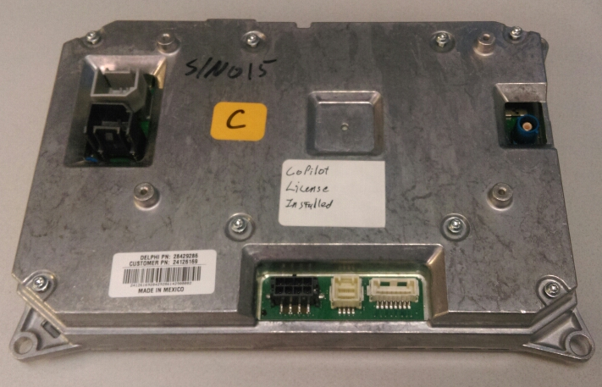
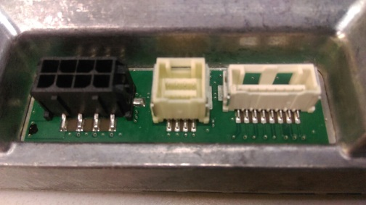
Adaptor Harness PP207020
Connection Display DEA 600
Display DEA 600 connection
Display DEA 600 connection

Slide 11
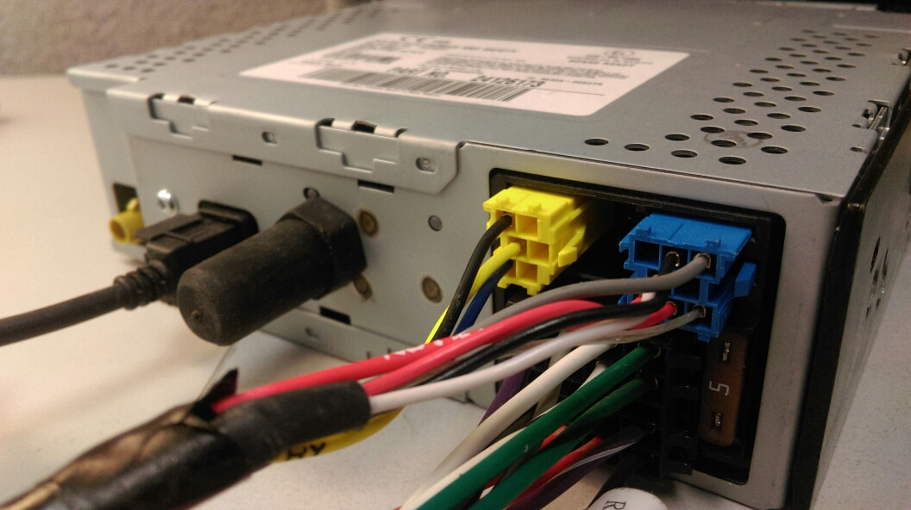
Adaptor Harness PP207020
Connection Radio Head Unit DEA 610
Radio Head Unit DEA 610 connection
P92-8917

Slide 12
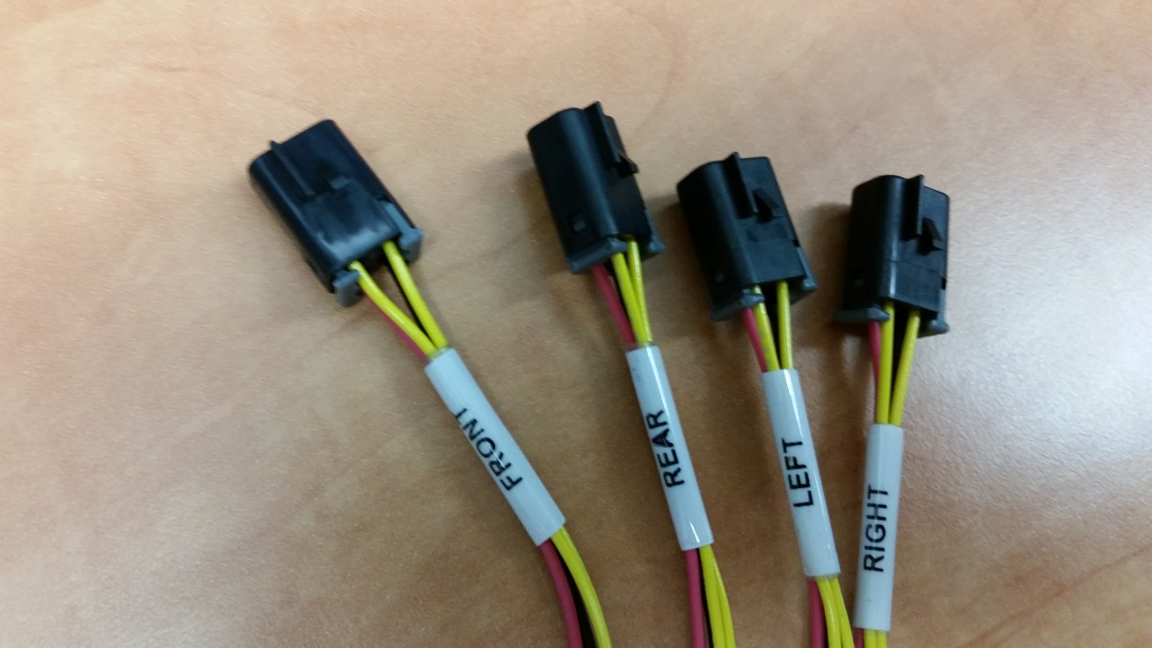
Camera Connections 4x Camera Inputs

Slide 13
Camera Configuration Options
Camera
Video Input 1 – Reverse (Back-up) Camera
Video Input 2 – Forward Facing Camera
Video Input 3 – Right Turn Camera
Video Input 4 – Left Turn Camera
Cameras can be configured to be selected manually or Automatically (Via J1939 CAN Messages)
In Manual mode the user select the camera view
In Auto mode the camera view is selected automatically depending on the truck state
Left turn signal active
Right turn signal active
Reverse active
Front default
Note the user may manually select the camera view when left, right turn signal or reverse is not active

Slide 14
Camera Views
Select camera views in “Home” screen to access the available camera views

Slide 15
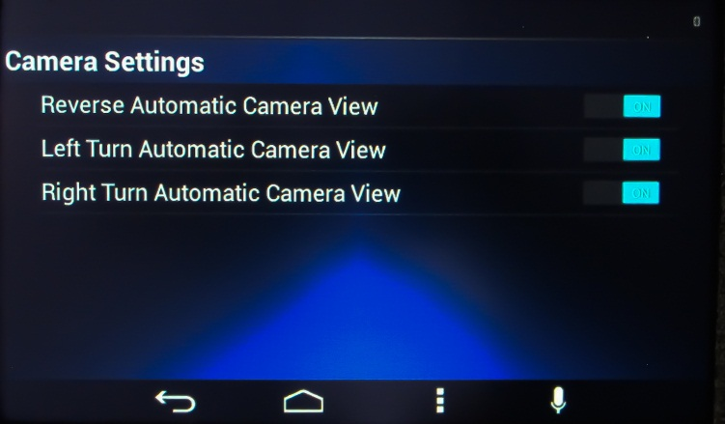
Camera Display Activation DEA 600
To configure the cameras within the DEA 600 Display
Enter camera views application select the desired camera view and activate “ON”

Slide 16
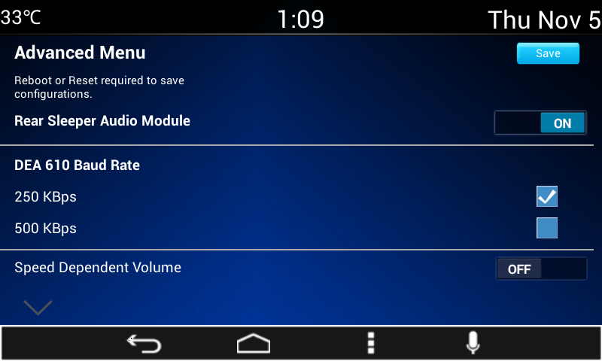
Camera Display Activation DEA 600
To configure the cameras within the DEA 600 Display
Enter the Advanced Menu and follow the steps:
Simultaneously select the following hard keys Home & Brightness . Hold for greater than 8 seconds. The display will enter the “Advanced Menu”
Scroll down to page 2

Slide 17
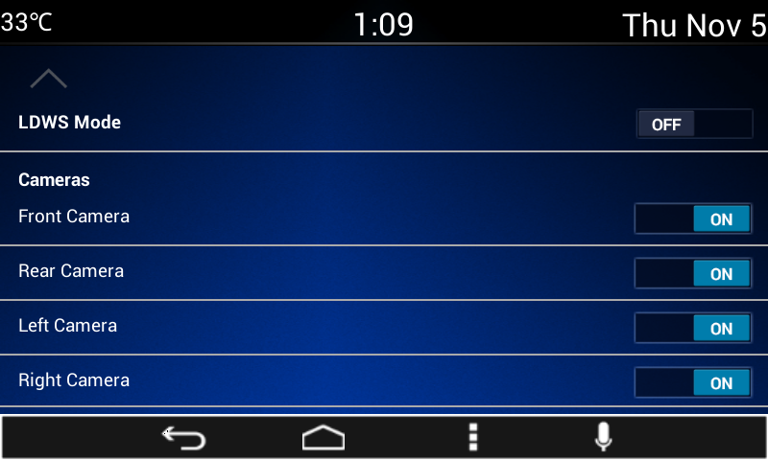
Camera Display Activation DEA 600
Page 2 Select Camera Required

Slide 18
Camera Display Activation DEA 600
Scroll up to page 1
Select “SAVE”
Pop Up Save Configuration appears “OK” or “Cancel” Select “OK”
System Reboots
Cameras are now active and manually selectable within the camera view menu
Completed
To set Cameras to Auto follow the steps above and continue the procedure using ESA. The ESA process is described in the next slides

Slide 19
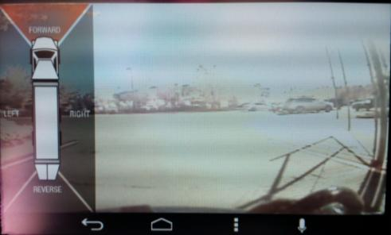
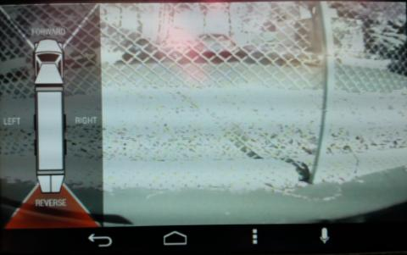
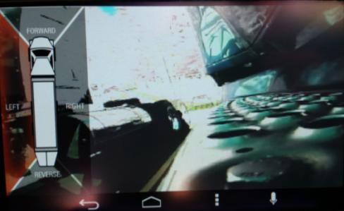
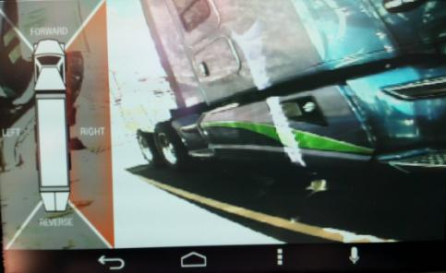
Camera Views
To activate a camera view, select the Forward, Right, Left or Reverse soft key indicated on the display truck graphic

Slide 20
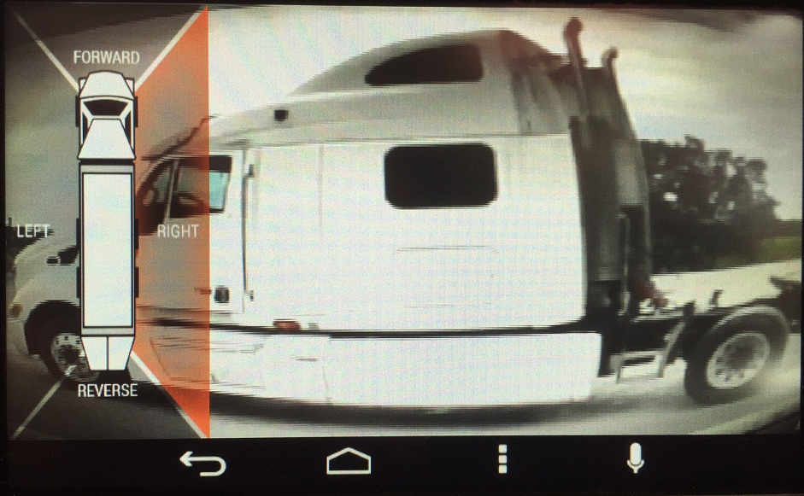
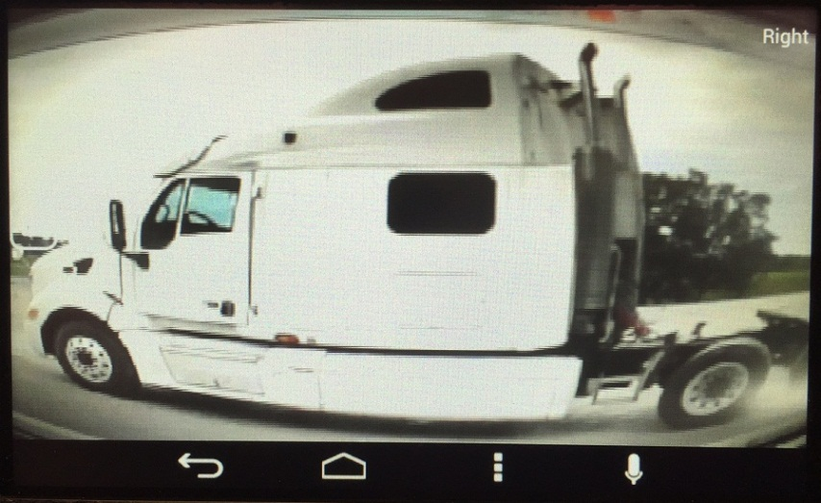
Example Camera View (Right)

Slide 21
Automatic Mode
Automatic Camera Mode by Model
Camera activation DEA 600
Cameras must be set to on within the DEA 600
Peterbilt Auto Camera Availability
Model | Auto Camera
325 | NO
330 | NO
337 | NO
348 | NO
382 | NO
320 | NO
365 | YES
367 | YES
389 | YES
587 | NO
567 | YES
579 | YES
Kenworth Auto Camera Availability
Model | LH Camera | RH Camera | Reverse Camera
T270 | YES | YES | NO
T370 | YES | YES | NO
T440 | YES | YES | ???
T460 | YES | YES | ???
T470 | YES | YES | ???
C500 | YES | YES | YES
T660 | YES | YES | YES
T680 | YES | YES | YES
T800 | YES | YES | YES
T880 | YES | YES | YES
W900 | YES | YES | YES

Slide 22
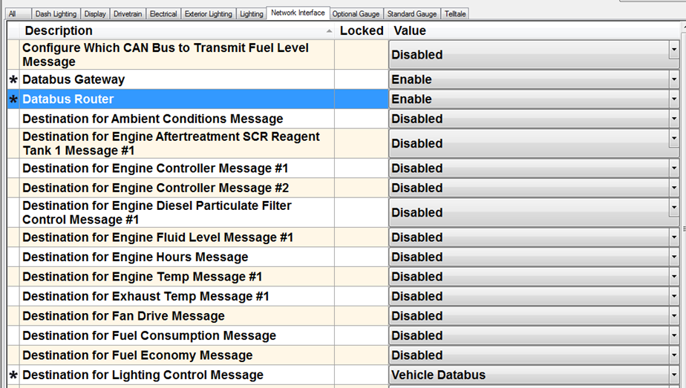
ESA Procedure for Setting Automatic Camera Mode
Program area of ESA (use the program button at top),
Look under the network interface tab.
Enable Router should be set to “Enable”
Transmit CECU LC Message should be set to “Gateway or Route to VCAN”
NAMUX 3

Slide 23
ESA Procedure for Setting Automatic Camera Mode
Program area of ESA (use the program button at top),
Look under the network interface tab.
Enable Router should be set to “Enable”
Transmit CECU LC Message should be set to “Gateway or Route to VCAN”
NAMUX 4

Slide 24
ESA Procedure for Setting Automatic Camera Mode
Program area of ESA (use the program button at top),
Look under the network interface tab.
Enable Router should be set to “Enable”
Transmit CECU LC Message should be set to “Gateway or Route to VCAN”
Once these are set, should see the lighting information on the bus.
Provides info SmartNav needs for the Automatic mode in the camera screen.
Note: Cameras will only work in automatic mode if the SmartNav is put in camera mode.
If in GPS mode or something else - camera view won't automatically pop up

Slide 25
J1939 CAN Messages
CAN Messages are used to activate camera views:
SPN 2367, PGN 65089 Left Turn Signal
SPN 2369, PGN 65089 Right Turn Signal
SPN 2391, PGN 65089 Backup Light
Note: no message to activate the forward facing camera. The only way for a user to access it is to go the camera screen under the truck menu where it is the default camera view.

