Slide 1
NEXT GENERATION
MULTIPLEXING

Slide 2
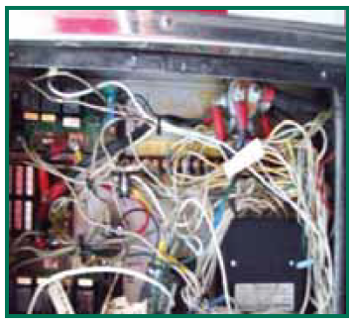
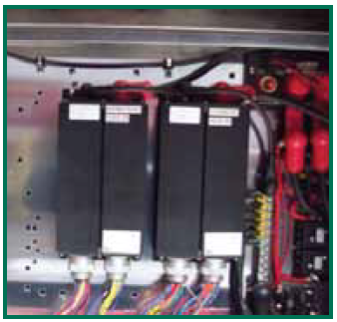
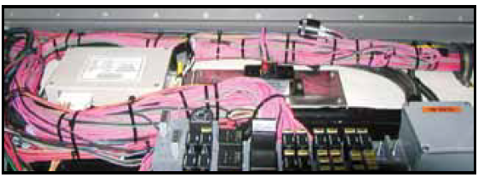
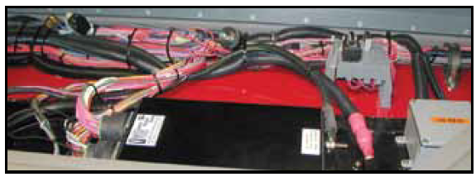
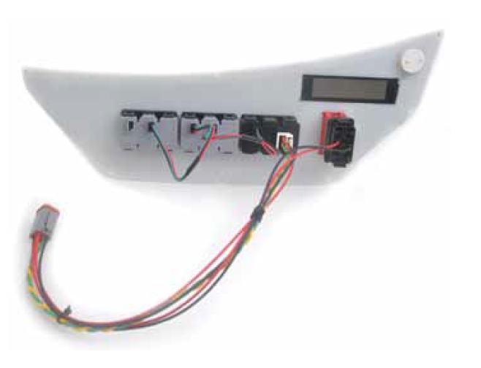
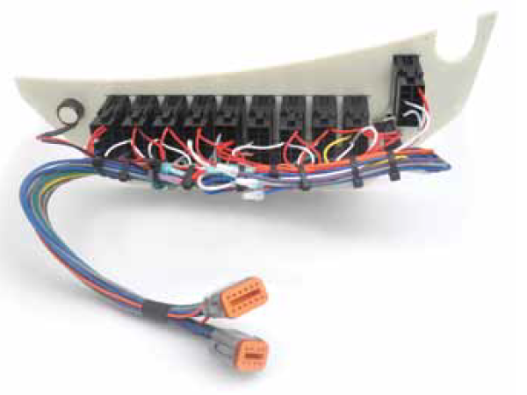
What is Multiplexing?
POINT TO POINT
MULTIPLEXING
Multiplexing is the combination of multiple analog or digital signals to a shared single signal.
Benefits
  Reduction of wiring
  Ability to control with modules/logic rather than wires and relays etc.
Notes:
https://en.wikipedia.org/wiki/Multiplexing

Slide 3
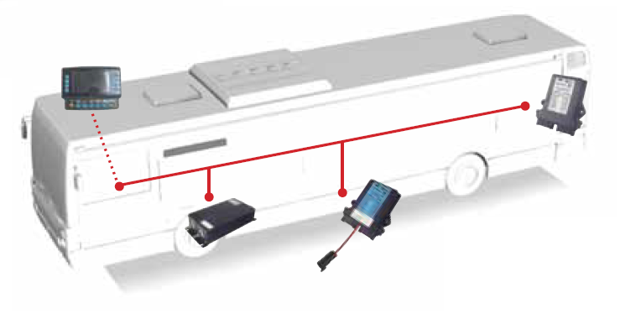
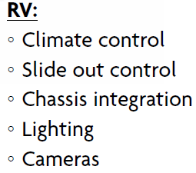
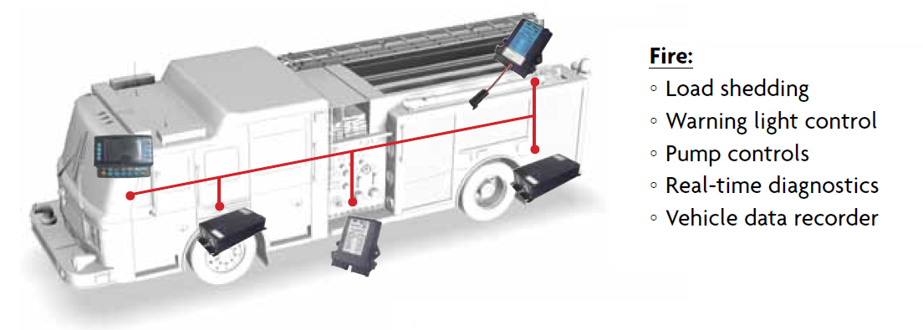
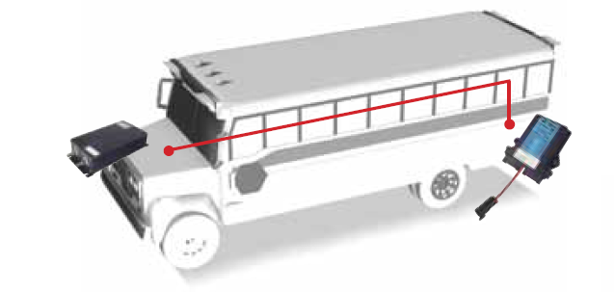
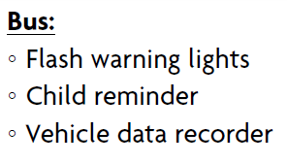
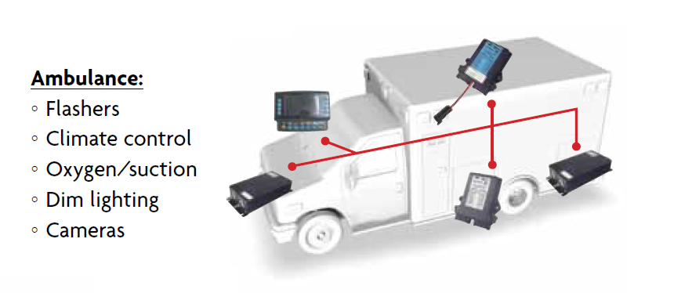
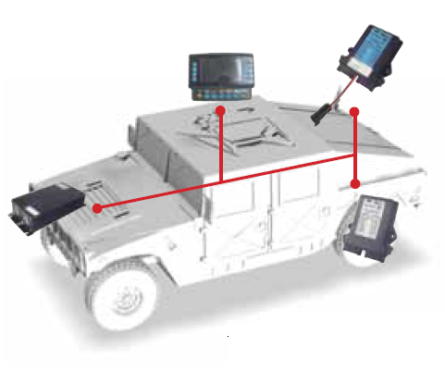
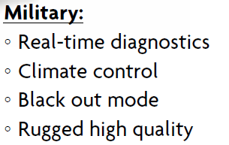
EXAMPLES

Slide 4
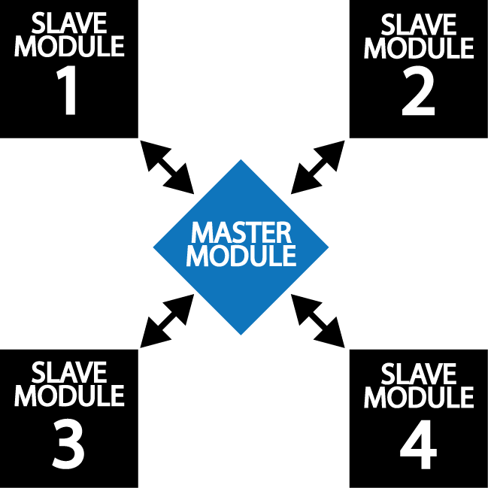
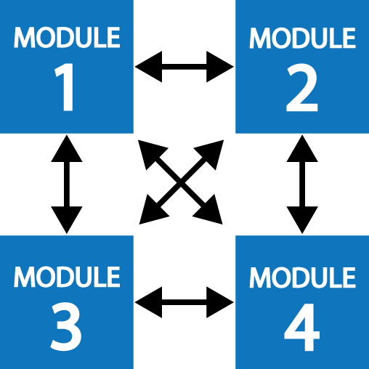
Multiplexing Systems
Our multiplex systems use peer-to-peer and master/slave
Current systems
  Master/slave (ES-Key)
  Only the master module contains the system file (database)
  Each module communicates only with the master module
  Peer-to-peer (V-mux)
  Each module contains its own system file
  Each module only communicates with its peer modules

Slide 5
COMMUNICATION METHODS
J1939 (ES-KEY)
RS485 (V-MUX)
SAE Industry Standard for Vehicle Bus communication including engine, transmission, and ABS brake messages
Speeds up to 250kbit/s baud rate but operates in real time
Distance up to 40m main
Distance of 1m for branch
Compatible with third party devices that use CAN communication
Data rate: 9.6kbit/s
Distance up to 100m (300ft)
Not a whole lot of third-party systems so have to convert everything over to CAN
Notes:
https://copperhilltech.com/a-brief-introduction-to-the-sae-j1939-protocol/

Slide 6
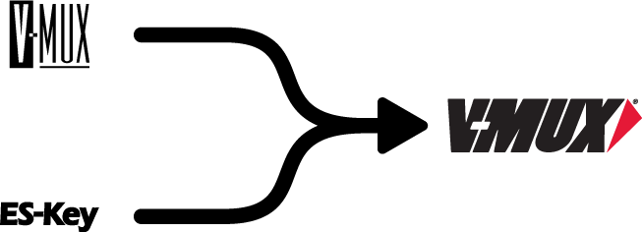
V-MUX and ES-Key systems are merging
  Peer-to-Peer network
  RS-485 communication
  Each module must be programmed with its own design file
  Each module only communicates with its peer modules
  Three programs: mux configurator, downloader, diagnostics
  Advanced hybrid network
  CAN communication, with ability to easily implement 3rd party CAN devices
  Only required to program one module with the design file
  Design can be pulled from the network (the design can be locked by the OEM)
  A single program to configure mux, configure displays (Vista and UltraView), reports, diagnostics, simulations, and downloads
  Master/slave network
  CAN communication
  Only one module must be programmed with the design file
  Each module only communicates with the master module
  Two programs: mux configurator, display configurator

Slide 7
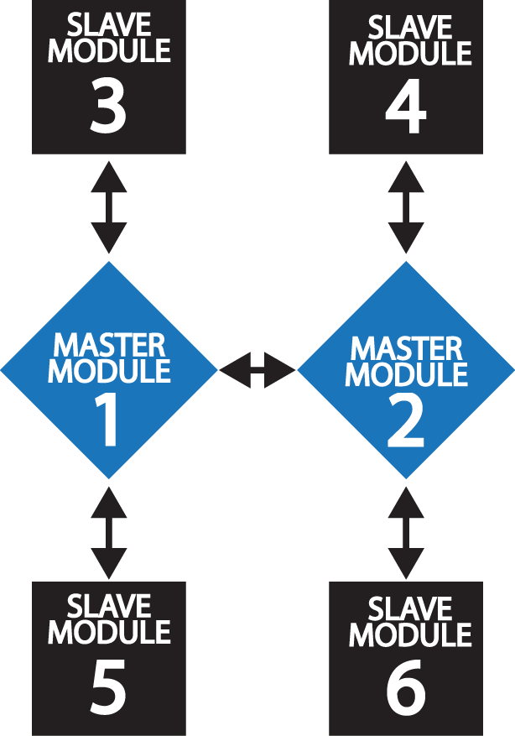
Multiplexing Systems
The Future
Allow the user to choose the network topology
  Master/Slave
  Peer-to-Peer
  Hybrid (Multi-Master)

Slide 8
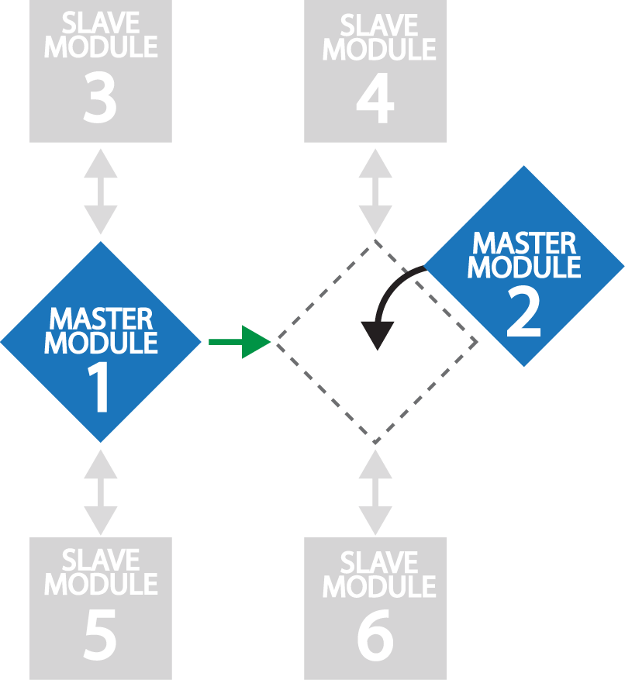
Multiplexing Systems
The Future
  Self-healing capability
  Each Master-capable module will contain the full design file
    Master-capable modules are: Hercules HC, Hercules V, 8x16, SuperNode
  If a Master-capable module is replaced then another Master-capable module can re-load its design file*
    Regardless of the topology chosen: master/slave, peer-to-peer, or hybrid (multi-master)
    *Does not include displays

Slide 9

Next generation
  Native Controller Area Network (CAN) communication
    Node-to-node communication utilizes this robust vehicle bus standard.
    User definable custom CAN libraries allow for 11-bit and 29-bit identifiers and 3rd part integration.
    SAE J1939 CAN library is standard.
    Configurable bus baud rate (125 kbit/s, 250 kbit/s, 500 kbit/s, 1 Mbit/s).
  Advanced hybrid network
    Dynamic address claiming to allow easy module installation and changes.
    System can be set up for peer-to-peer or master/slave.
    Feasibility study underway to determine if a “self-heal” capability can be implemented [a replaced node(s) program can be automatically updated by the other node(s) in the system].
  Visual design language
    Easy to follow, point-to-point design elements.
    Visual representation of nodes and their pin-to-logic associations.
  Singular focus – on our customers
    Listening to what is important to our customer’s leadership, sales people, designers, and markets.
  Display technology
    UltraView is incorporated and we will also provide integration of Vista display configurator as part of the new V-MUX configuration software.
    UltraView displays use the latest technologies to allow creating the best user interfaces and branding platforms.
  Captium telematics
    Cellular based, utilizing secure cloud servers. Highly controlled and more data protected than Wi-Fi systems.

Slide 10
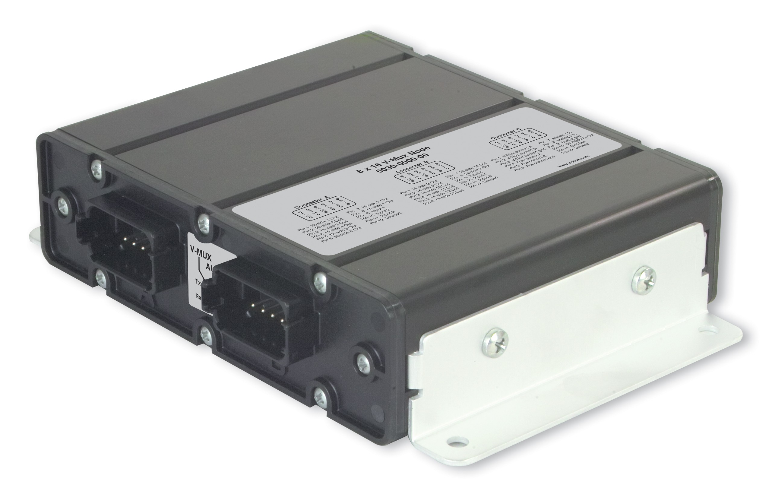
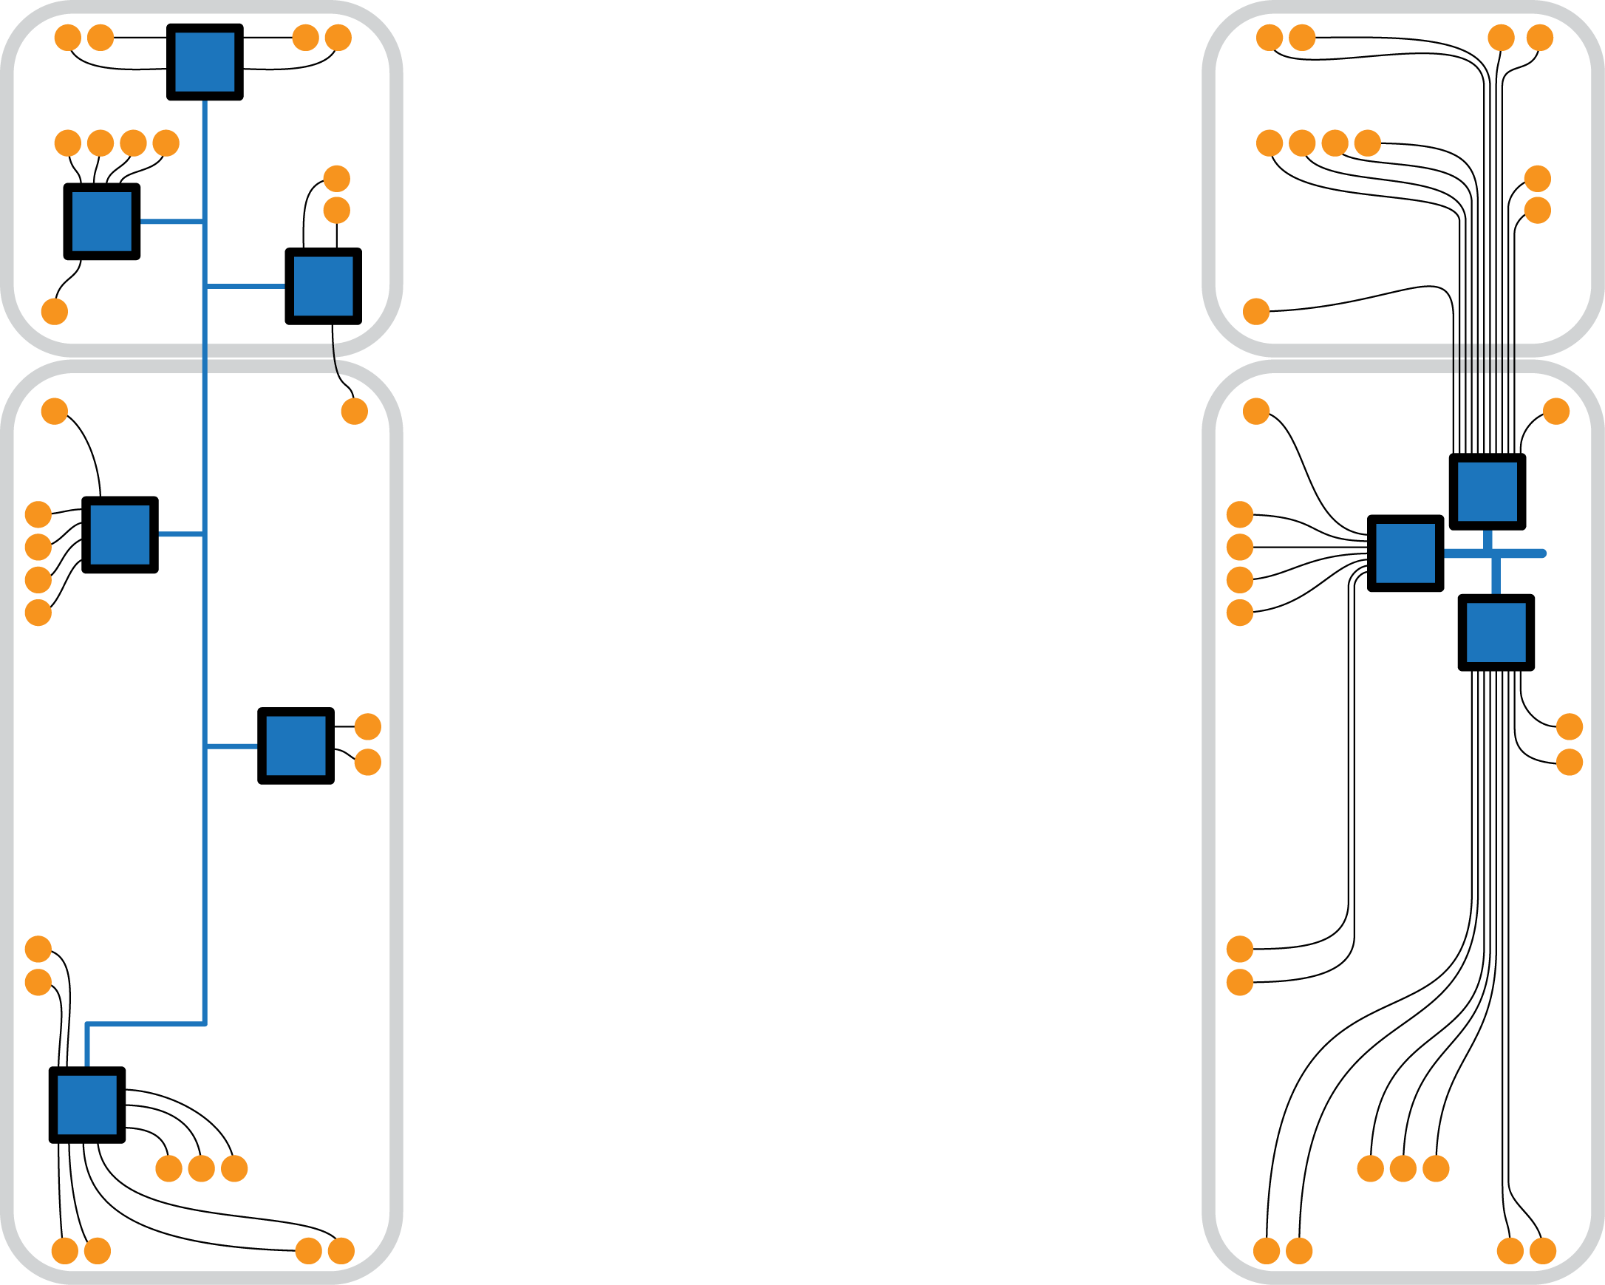
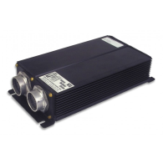
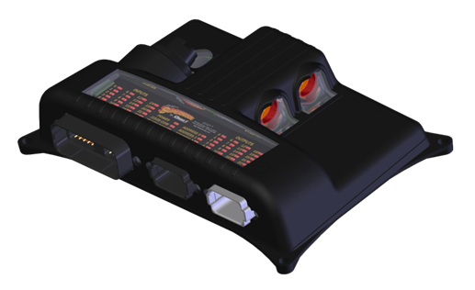
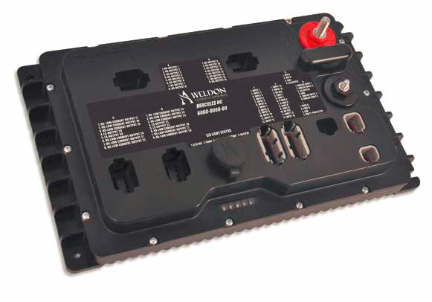
Next generation V-MUX
Use existing nodes
  Minimal to no impact – existing harnesses and modules can be used.
  All modules will use CAN communication.
  Broadens the module portfolio – both
  V-MUX and ES-Key modules can be mixed.
  Allows placement flexibility (centralized/distributed).
  Must use one Master node:
    8x16
    Herc V
    Supernode II
    Hercules HC

Slide 11
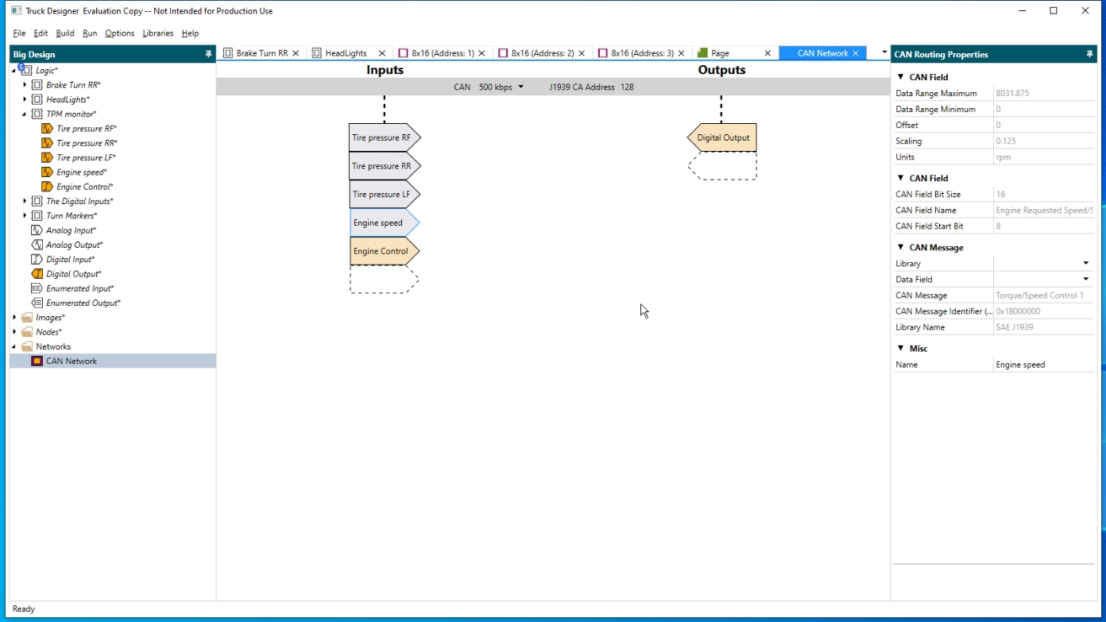
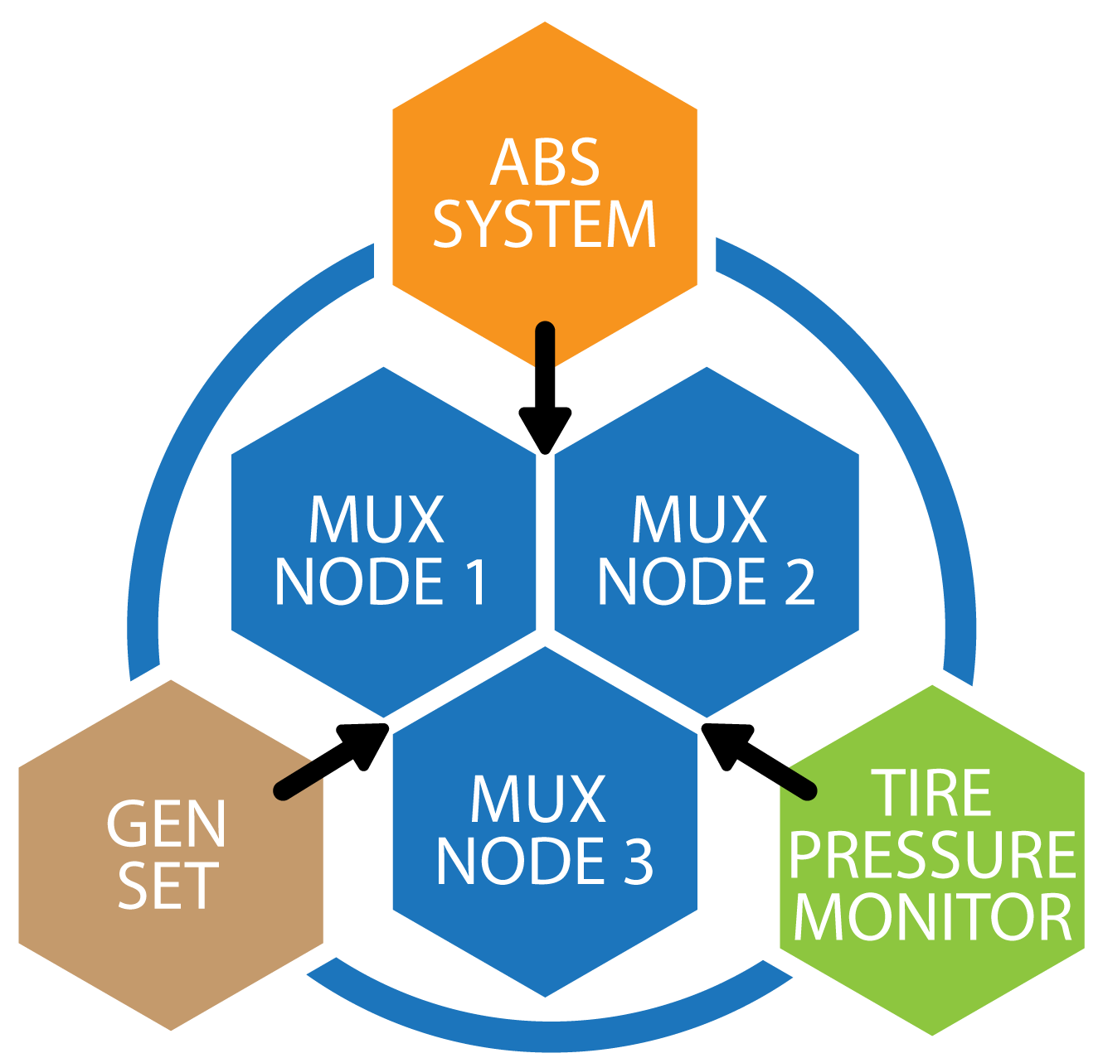
Next generation V-MUX
Custom CAN messaging
  Integrated method to communicate with 3rd party devices (generators, tire pressure monitoring, etc).
  Entire SAE J1939 library is built in.
  New CAN messaging can be created and saved to a library.

Slide 12
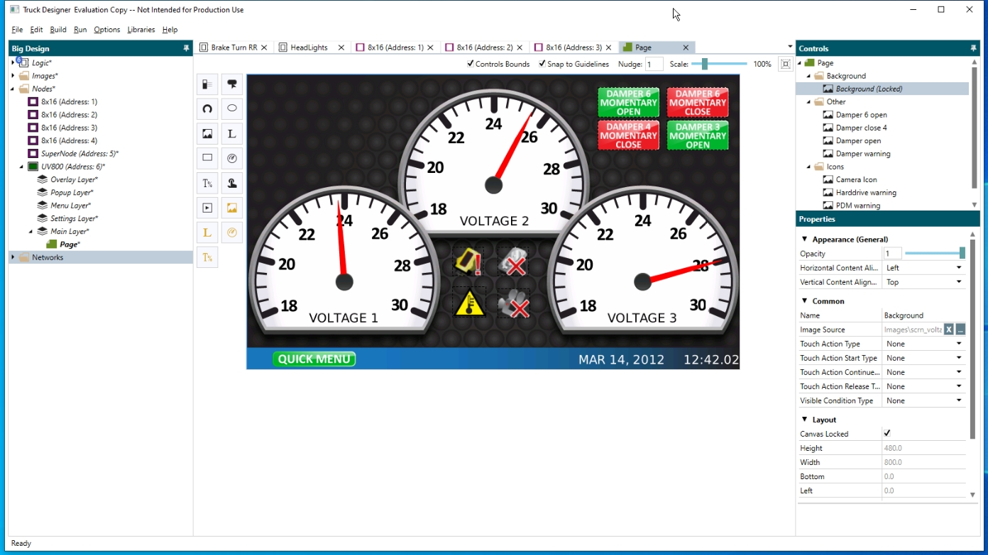
Next generation V-MUX
Integrate UltraView displays
  Simpler display configurator.
  Ability to save previous screen to a catalog for easy reuse.
  Easily connect Logic I/O to display elements.
  Native communication with
  V-MUX nodes in the design.
  Similar functions as Vista displays with SystemDesigner

Slide 13
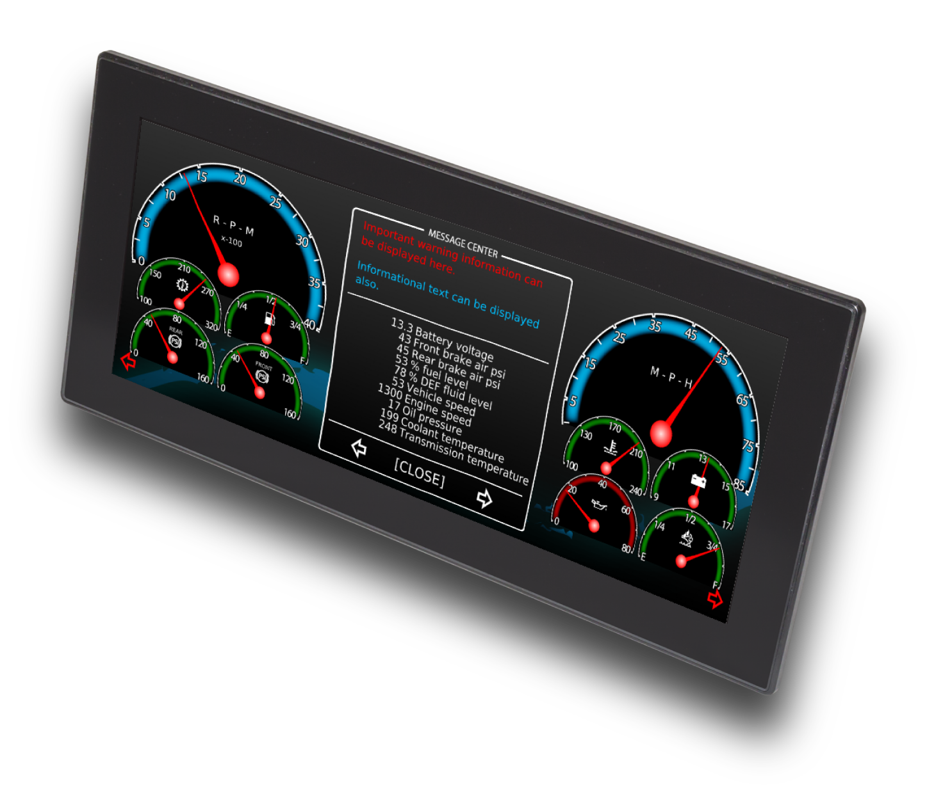
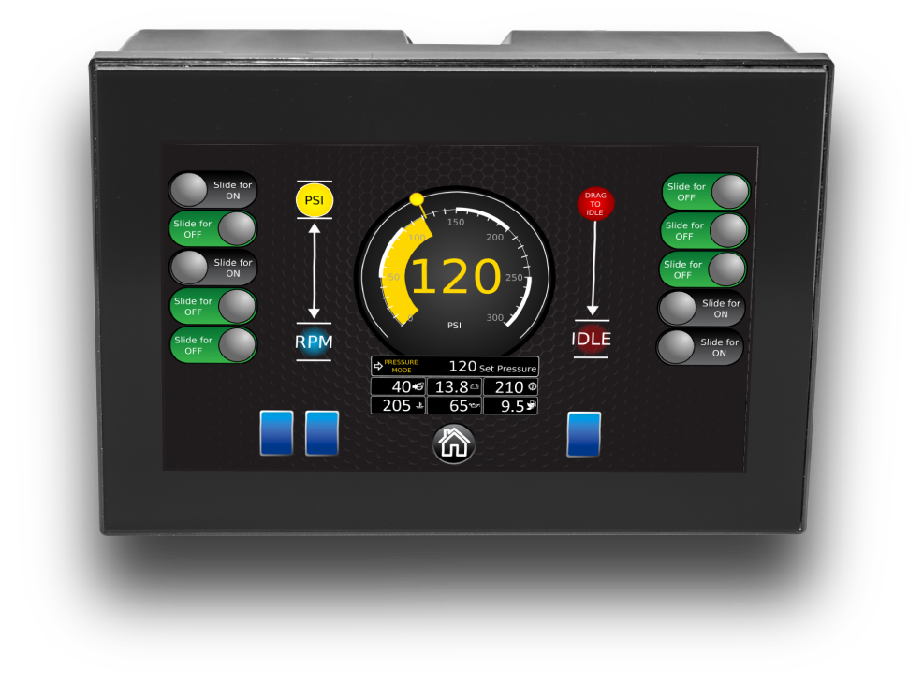
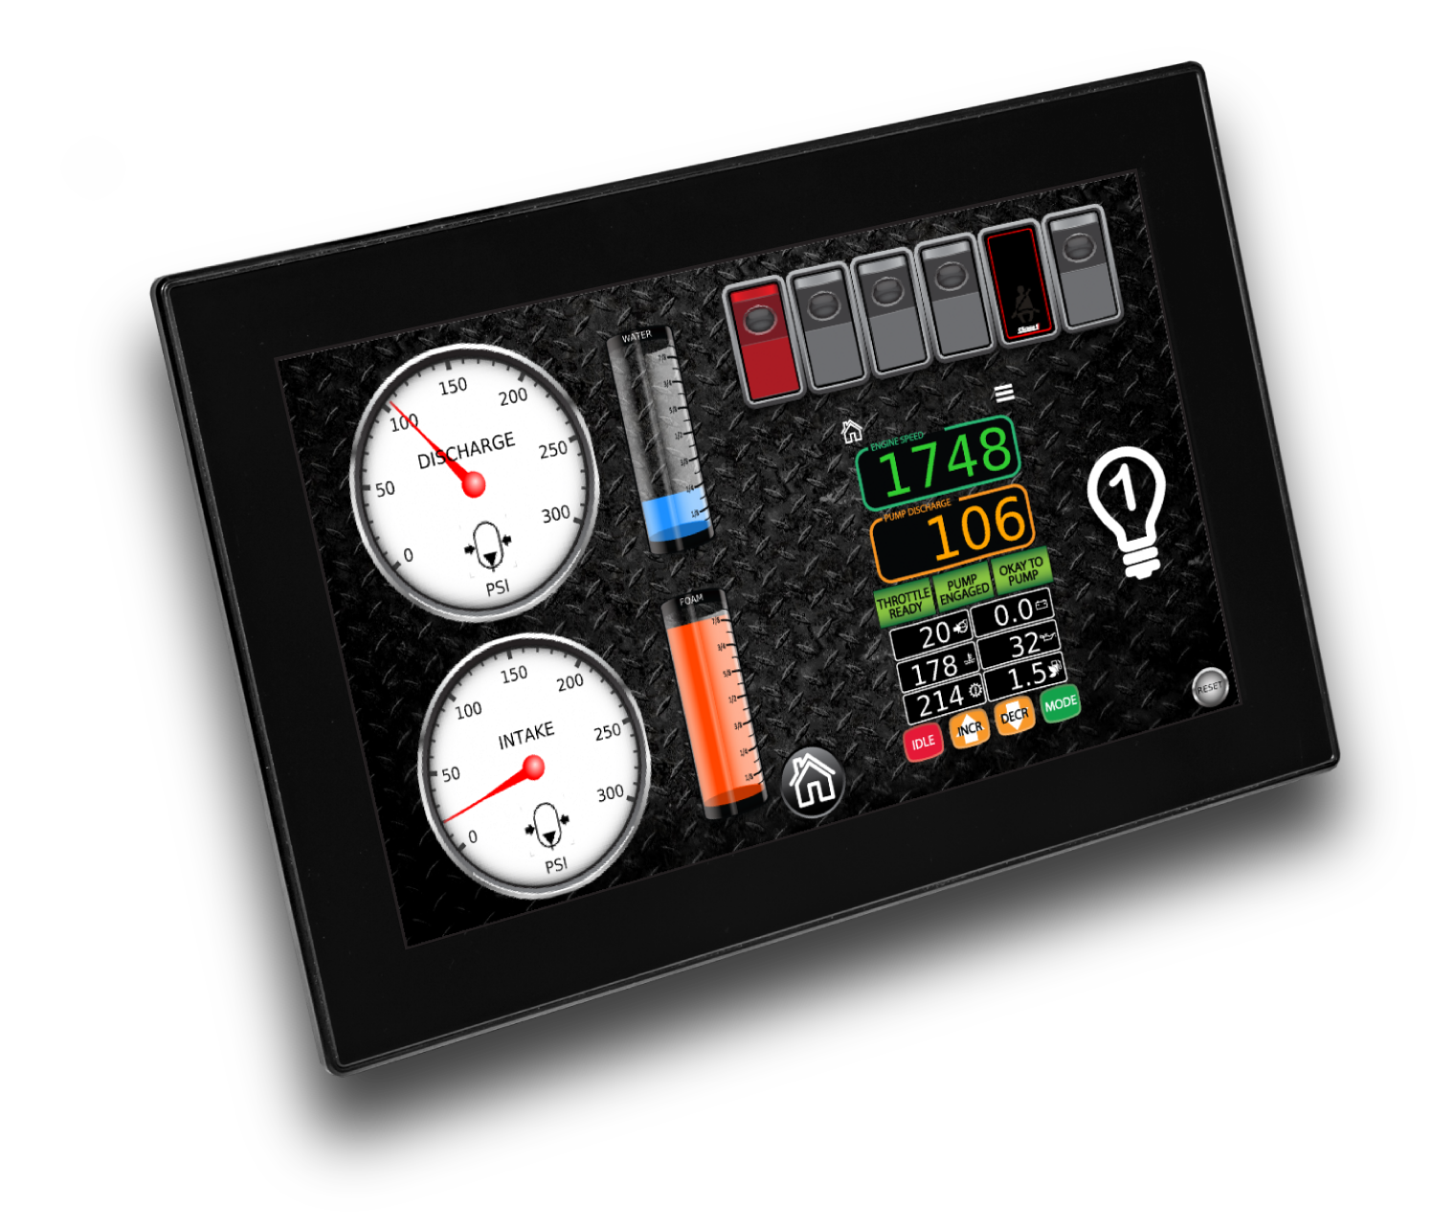
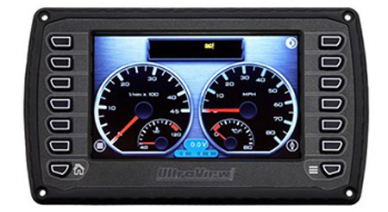
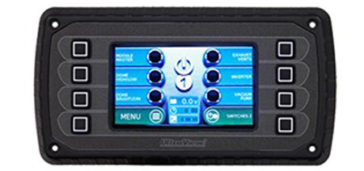
Next generation V-MUX
Integrate UltraView displays
  Modern look, full sunlight viewability.
  Displays sizes: 12.3”, 10.6”, 7.0”, 5.0”, 4.3”
  Latest generation PCAP technology with dual-touch capability.
  Versions with touch-only or buttons and touch
  PowerVision software can still be used for complex configurations.

Slide 14
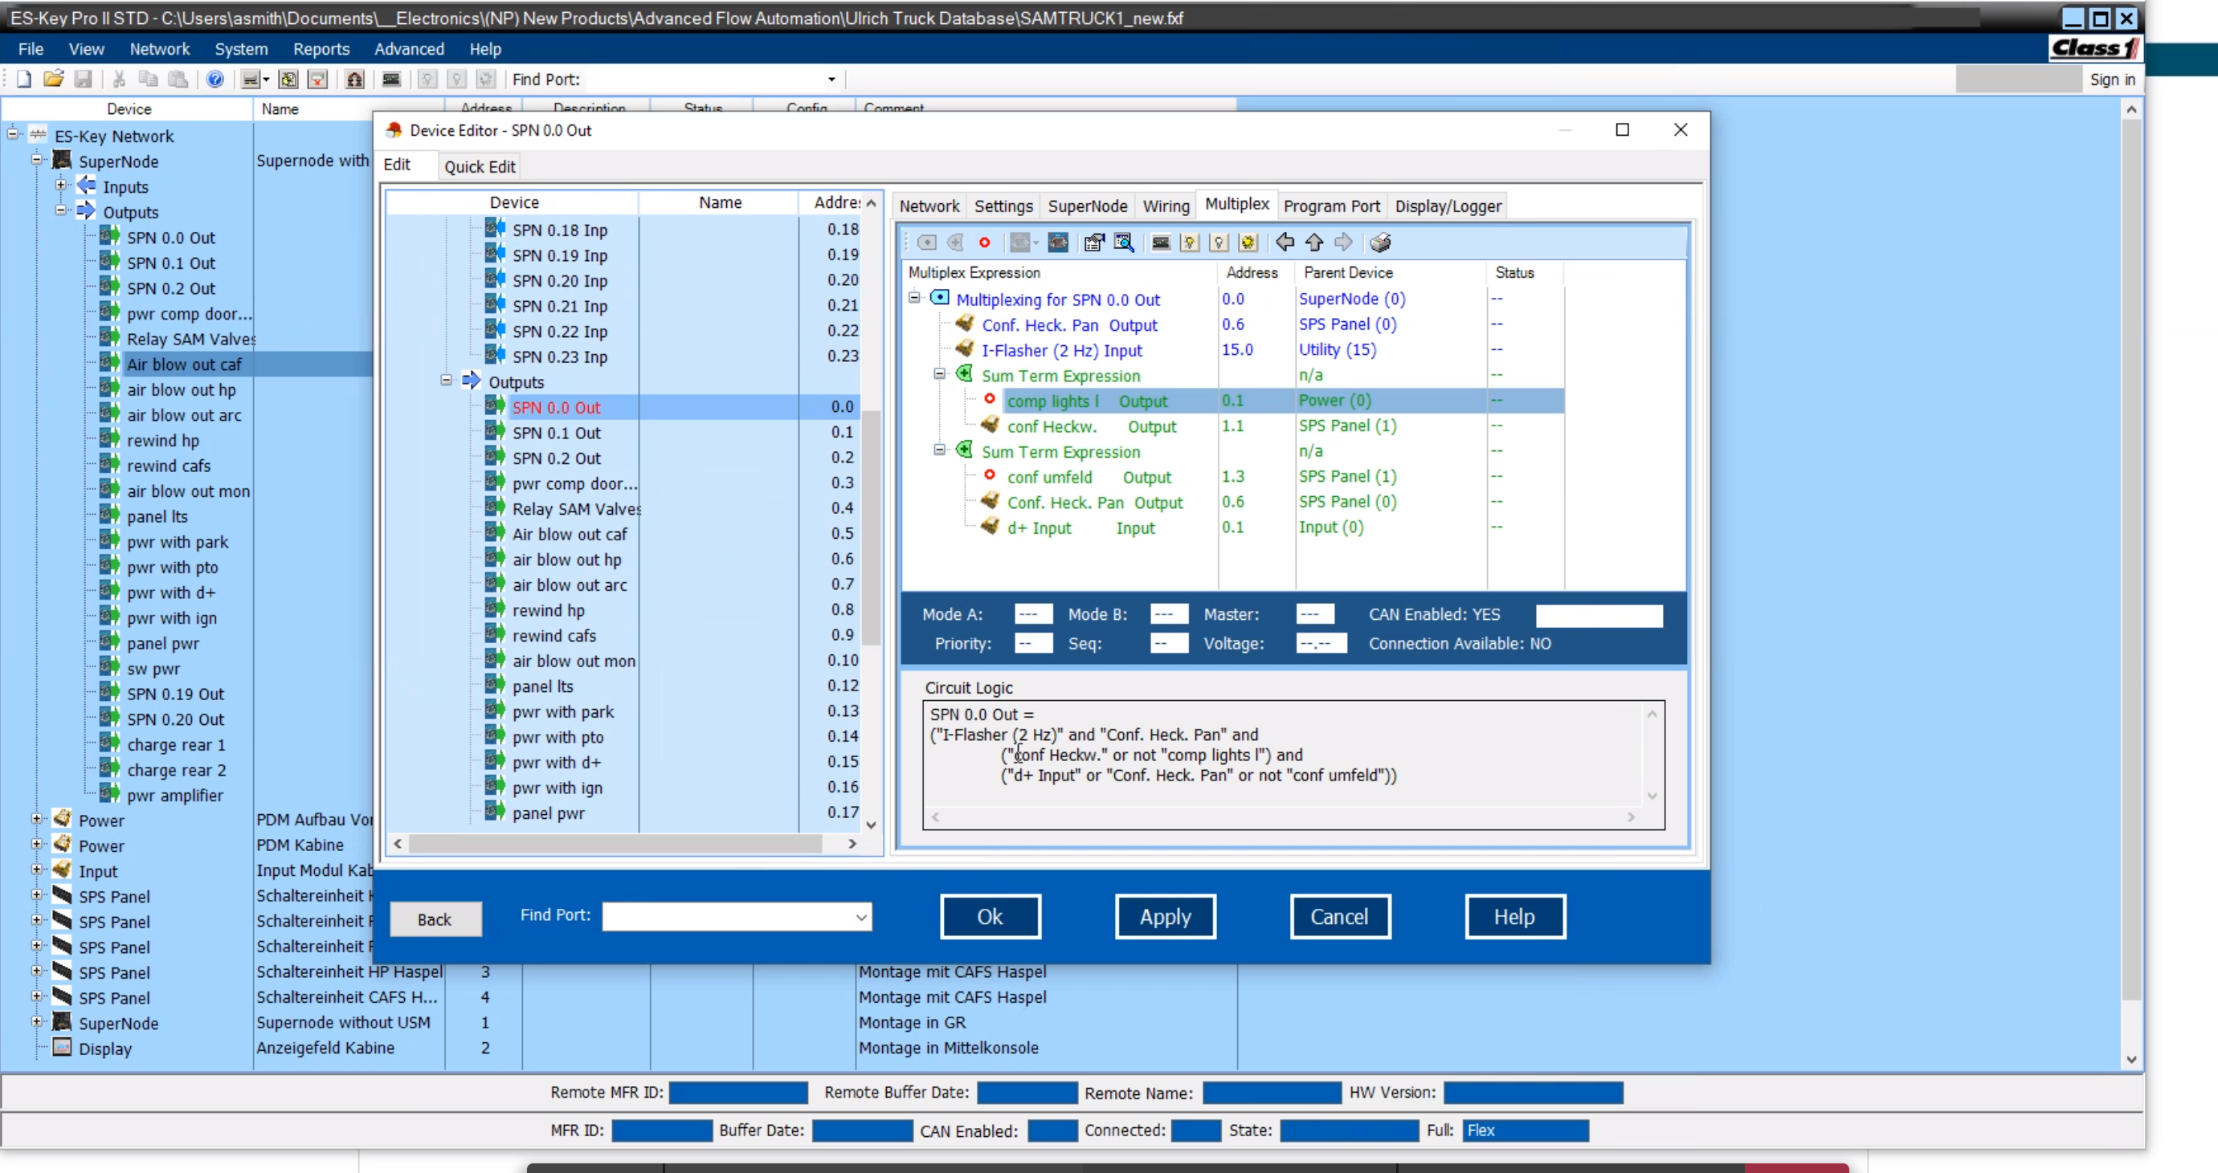
The ES-Key Professional
Configuration made easy. The ES-Key Professional software provides you with a quick and easy way of programming your vehicle. An extensive report feature documents your system as you program. Logic as simple or as complex as necessary to accomplish your goal. You control the program so you’re in charge. Wire your vehicles the same and change their behavior by simply changing the program. Activate options, change flash patterns and load management setting without changing a single wire. Allows the OEM to configure the vehicle
Use simple logic statements.
Unlimited load management
Archive all custom designs for future use
Use virtual circuits to create custom program functions
Automatically create printable system reports
Configure display messages
Real Time Diagnostics

Slide 15
V-MUX® SystemDesigner® Software
The V-MUX® SystemDesigner software is an all encompassing tool that allows you to configure your electrical system from the ground up. Whether it is assigning commands to inputs, then assigning those commands to turn on outputs, configuring the climate control, or designing attractive graphics for your application... SystemDesigner does it all!
Allows the OEM to configure the vehicle
User friendly Windows® based software
Self reliant programming in the hands of the OEM
Archive all custom designs for future use
No need to have programmers on staff

Slide 16
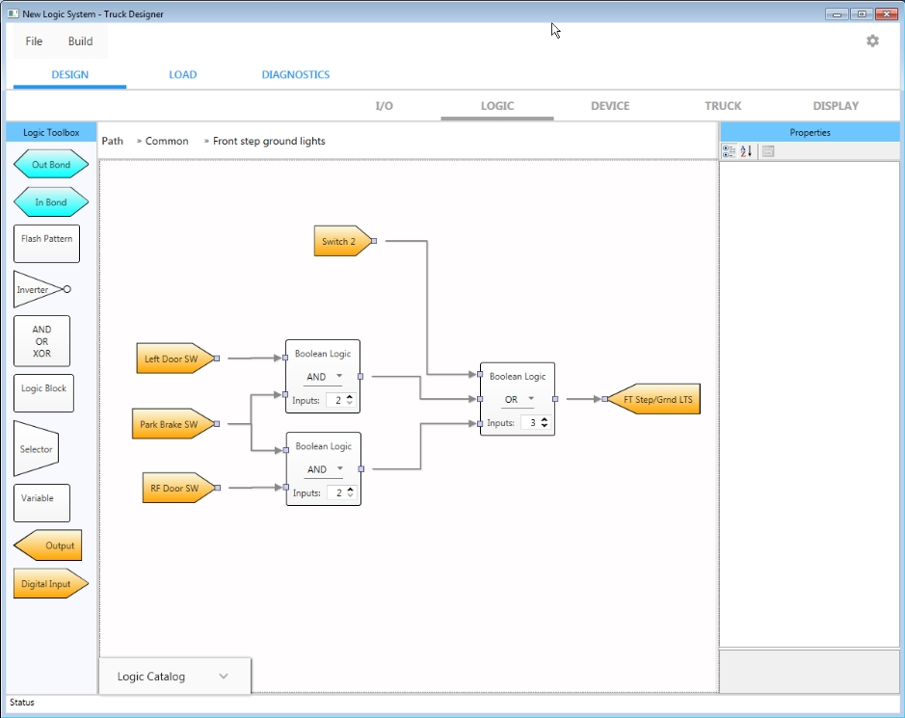
New V-MUX multiplex system – easier software
Visual drag-and-drop design language.
More intuitive and understandable workflow.
Only one software program is required for all tasks
  Programming
  Reports
  Downloading
  Diagnostics
  Simulation
  Display programming

Slide 17
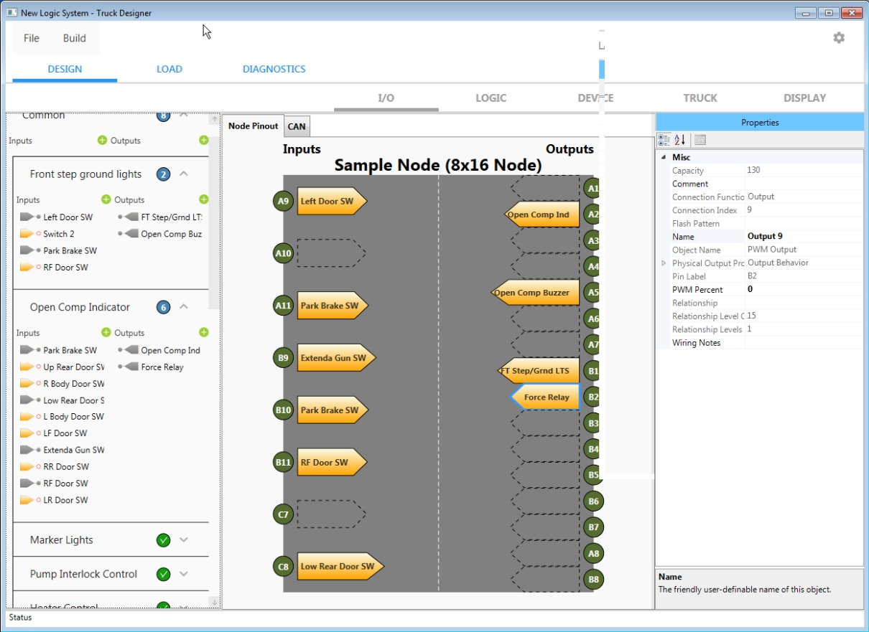
New V-MUX multiplex system – easier software
Easy to map logic I/O to node pins.
Pin-to-logic associations can be easily remapped.
Pin location highlighting indicates where a logic I/O can be connected.
CAN assignments are just as easy utilizing the libraries (standard and custom).

Slide 18
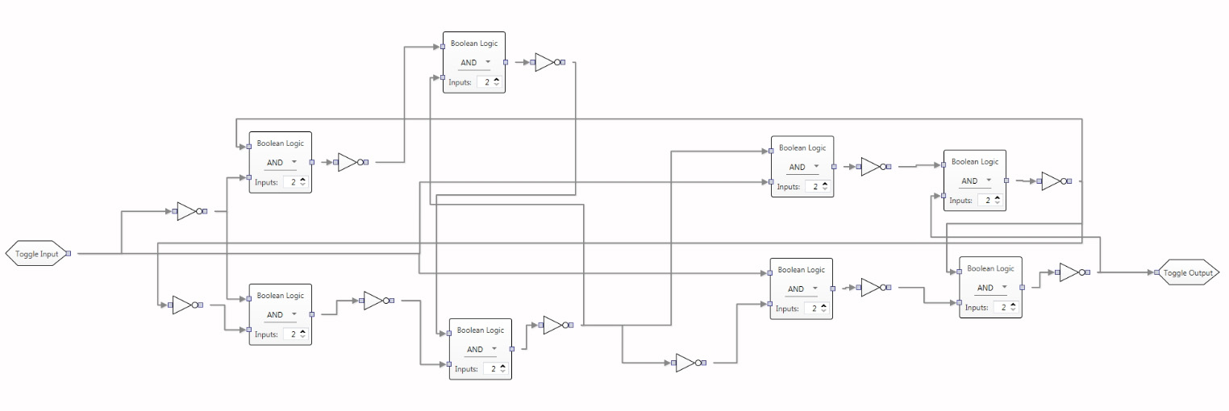
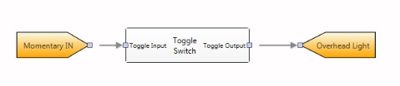
New V-MUX multiplex system – faster development
Complex design function…
Take complex functions and encapsulate into a custom designer block.
Custom blocks can be easily saved, shared, and re-used.
…saved as a custom, re-usable logic block.

Slide 19
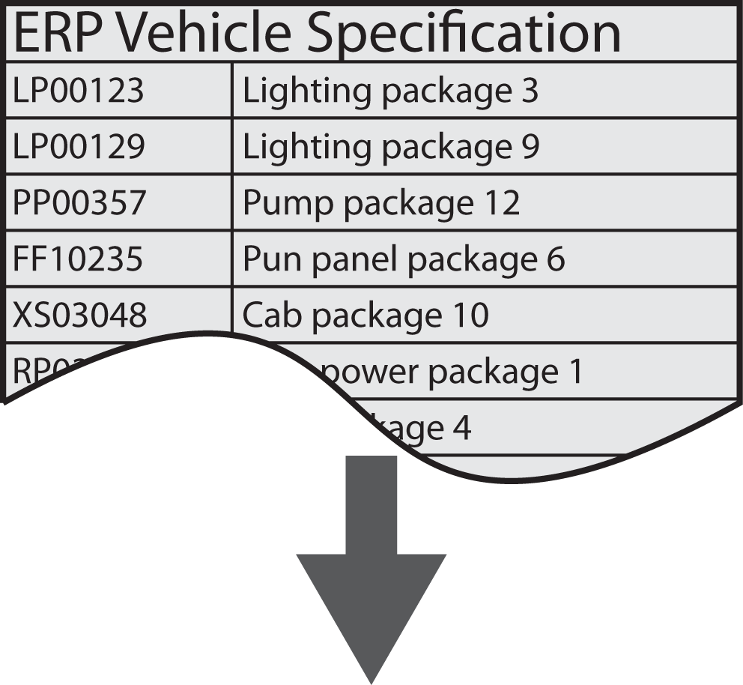
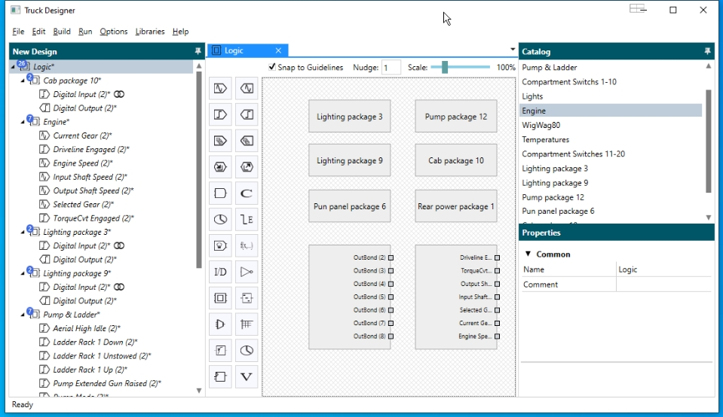
Next generation V-MUX
Faster development
  Save commonly used logic into the catalog.
  Automate designs by importing sales codes and deploying logic blocks from the custom catalog.

Slide 20
COMING SOON
Easier software (and only one software program required)
Faster development and throughput
Integrate with your ERP system
Backwards compatible with existing V-MUX and ES-Key modules
Choice the use of UltraView and Vista displays
Diagnostics and reporting

Slide 21
LET’S TAKE A LOOK…
CLICK TO START

