Slide 1
AS400 (ERP) System Overview

Slide 2
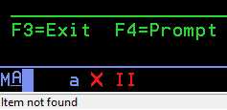
General Notes
F12 to Cancel task (go back one screen)
F3 to Exit task (go back to main menu)
If you enter non-valid information, you will see two red bars appear at the bottom left-hand corner of your screen with text stating “Item not found” – you will also hear a chime noise if your volume is on.
To be able to type again you will need to select the Control (Ctrl) button you’re your keyboard.

Slide 3
Login
Username: MACK
Tab to password line
Password: MACK
The Password will not appear as you type it.
Enter button on keyboard to login

Slide 4
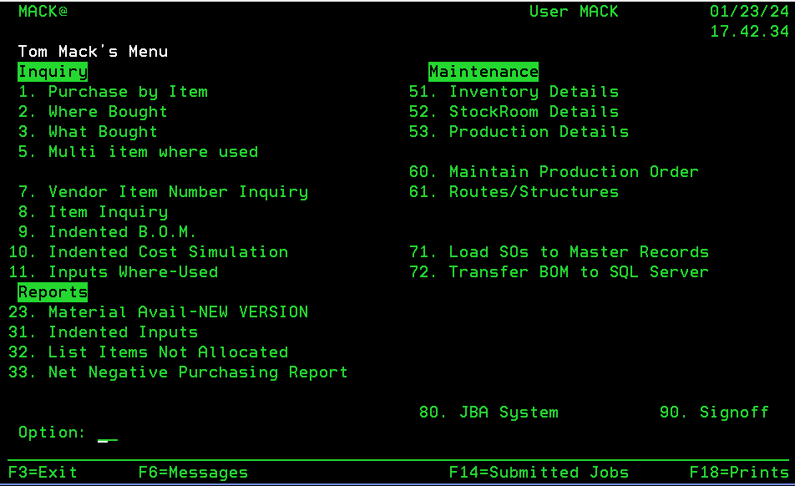
Navigating to Main Menu
Initial Login Page
Main Menu Screen
Enter in part#/Group number in question on Item Line
Type ST on the Stockroom line
This will give you general info about the part or group
Select F3 to access the main menu screen from the initial login screen

Slide 5
Key Menu Options
#9 Indented BOM – Breaks down all groups to the part level
#11 Where Used – Search what groups a part is structured in
#51 Inventory Details – Edit the description of a part
#52 Stockroom Details – suppliers, material cost, purchasing UOM and standard cost
#53 Production Details – Specifies if the item# is a group or part. This is where engineering will change the revision level of an item to ensure purchasing purchases the correct revision on their PO.
#60 Maintain production order – Generate MOs
#61 Routes/structures – Create and alter BOMs

